Slide 1

TOPSELLER
QUICK REFERENCE GUIDE
Canada | 2024
V5 2024

Slide 2
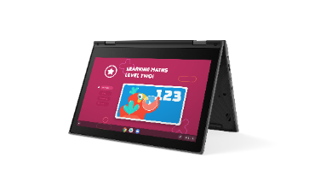
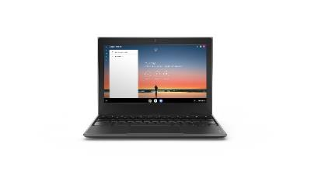
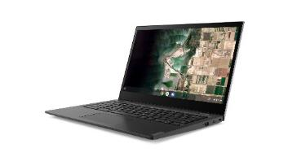
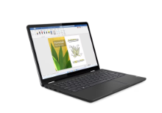
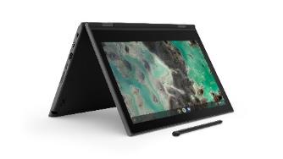
LENOVO TOPSELLERS - EDUCATION
[ 1 OF 1 ]
100e Chromebook G4 – | $369
 | 82W00001US
 | 82W00001CF
 | MediaTek MT8183
 | 4GB (soldered)
 | 32GB eMMC (soldered)
 | 11.6” HD TN Anti-glare
 | HD Camera, 2x2 AX WLAN, BT
 | 47Whr Battery
 | Chrome OS
 | 1 Year Mail-in
100e Chromebook G3 – Intel | $369
 | 82UY0000US
 | Intel Celeron N4500
 | 4GB (soldered)
 | 32GB eMMC (soldered)
 | 11.6” HD TN Anti-glare
 | Camera, 2x2 AC WLAN, BT
 | 42Whr Battery
 | Chrome OS
 | 1 Year Mail-in
500e Chromebook G3 | $489 | $499
 | 82JB003XUS | 82JB0001US
 | 82JB003XCF | 82JB0001CF
 | Intel Celeron N4500 | Intel Celeron N5100
 | 4GB (soldered) | 4GB (soldered)
 | 32GB eMMC (soldered) | 32GB eMMC (soldered)
 | 11.6" HD IPS Touch | 11.6" HD IPS Touch
 | HD Camera, 2x2 AX WLAN, BT | World Facing Camera, 2x2 AC WLAN, BT, Pen
 | 42Whr Battery | 42Whr Battery
 | Chrome OS | Chrome OS
 | 1 Year Mail-in | 1 Year Mail-in
14e Chromebook G3 | $499
 | 82W60000US
 | 82W60000CF
 | Intel N100
 | 4GB (soldered)
 | 32GB eMMC (soldered)
 | 14" HD TN Anti-glare
 | HD Camera, 2x2 AX WLAN, BT
 | 57Whr Battery
 | Chrome OS
 | 1 Year Mail-in
13W Yoga G2 - Windows | $1189
 | 82YR0009US
 | 82YR0009CF
 | AMD Ryzan 5 7530U
 | 4GB (soldered)
 | 256GB SSD
 | 13.3” WUXGA IPS, Gorilla Glass, Touch, Anti-Fingerprint, Integrated Pen
 | Front FHD 1080P/Rear5 MP Wi-Fi 611ax 2x2, BT
 | 51Whr Battery
 | Win 11 Pro
 | 1 Year Mail-in
300e Chromebook
300e Chromebook G4 – MTK | $449 | $499
 | 82W20003US | 82W20002US
 | 82W20003CF | 82W20002CF
 | MediaTek MT8183 | MediaTek MT8183
 | 4GB (soldered) | 4GB (soldered)
 | 32GB eMMC (soldered) | 32GB eMMC (soldered)
 | 11.6” HD IPS Touch | 11.6” HD IPS Touch
 | HD Camera, 2x2 AX WLAN, BT | World Facing Camera, 2x2 AX WLAN, BT, Pen
 | 47Whr Battery | 47Whr Battery
 | Chrome OS | Chrome OS
 | 1 Year Mail-in | 1 Year Mail-in
14e Chromebook
13W Yoga G2
100e Chromebook
500e Chromebook

Slide 3
Lenovo Premium Notebooks

Slide 4
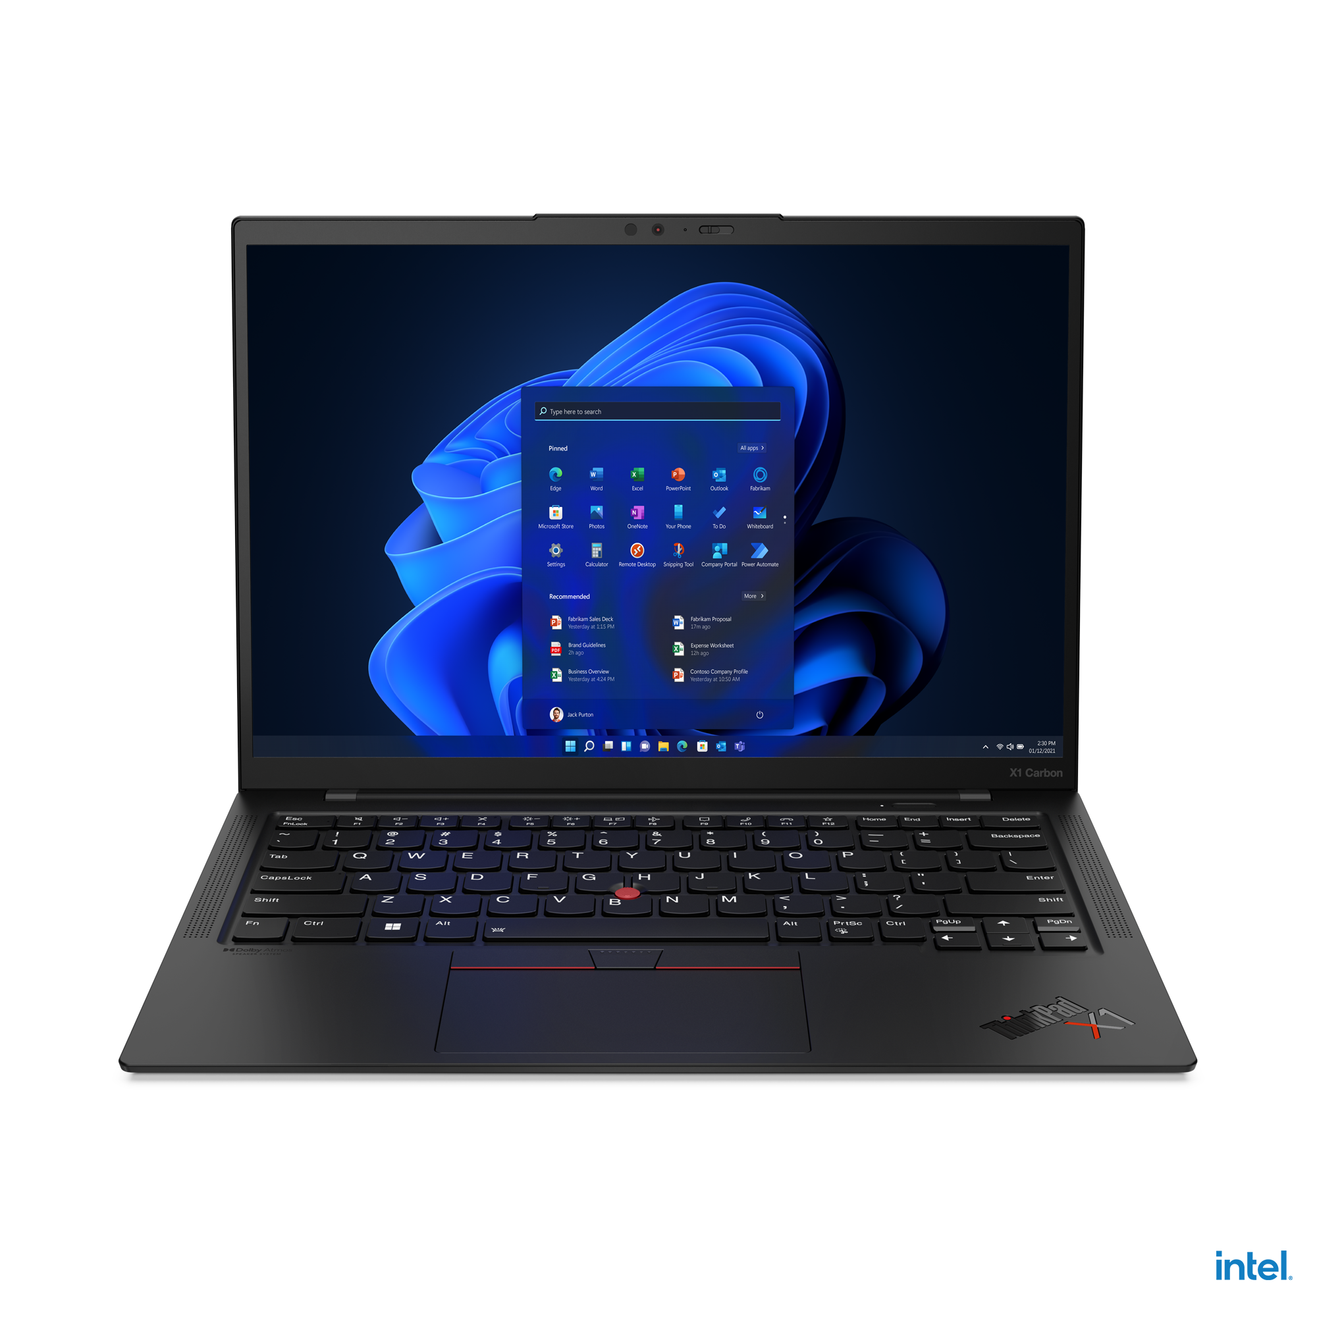
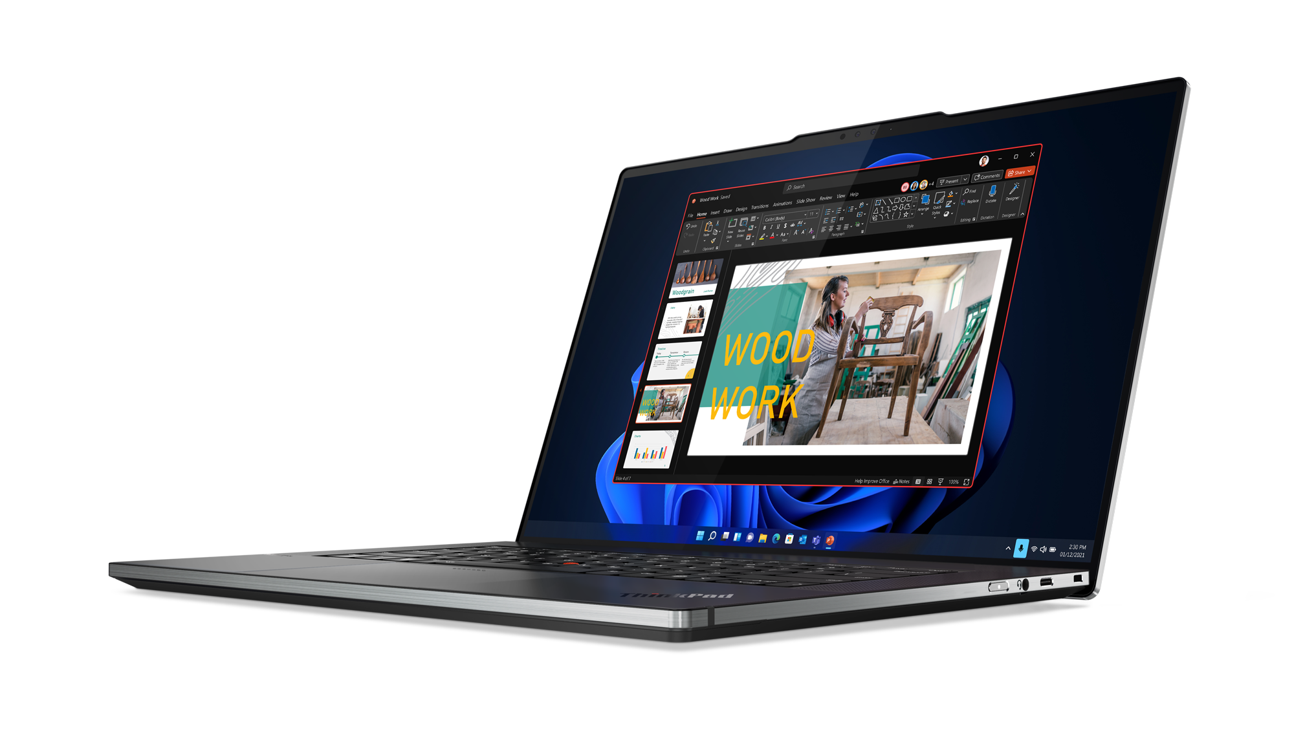
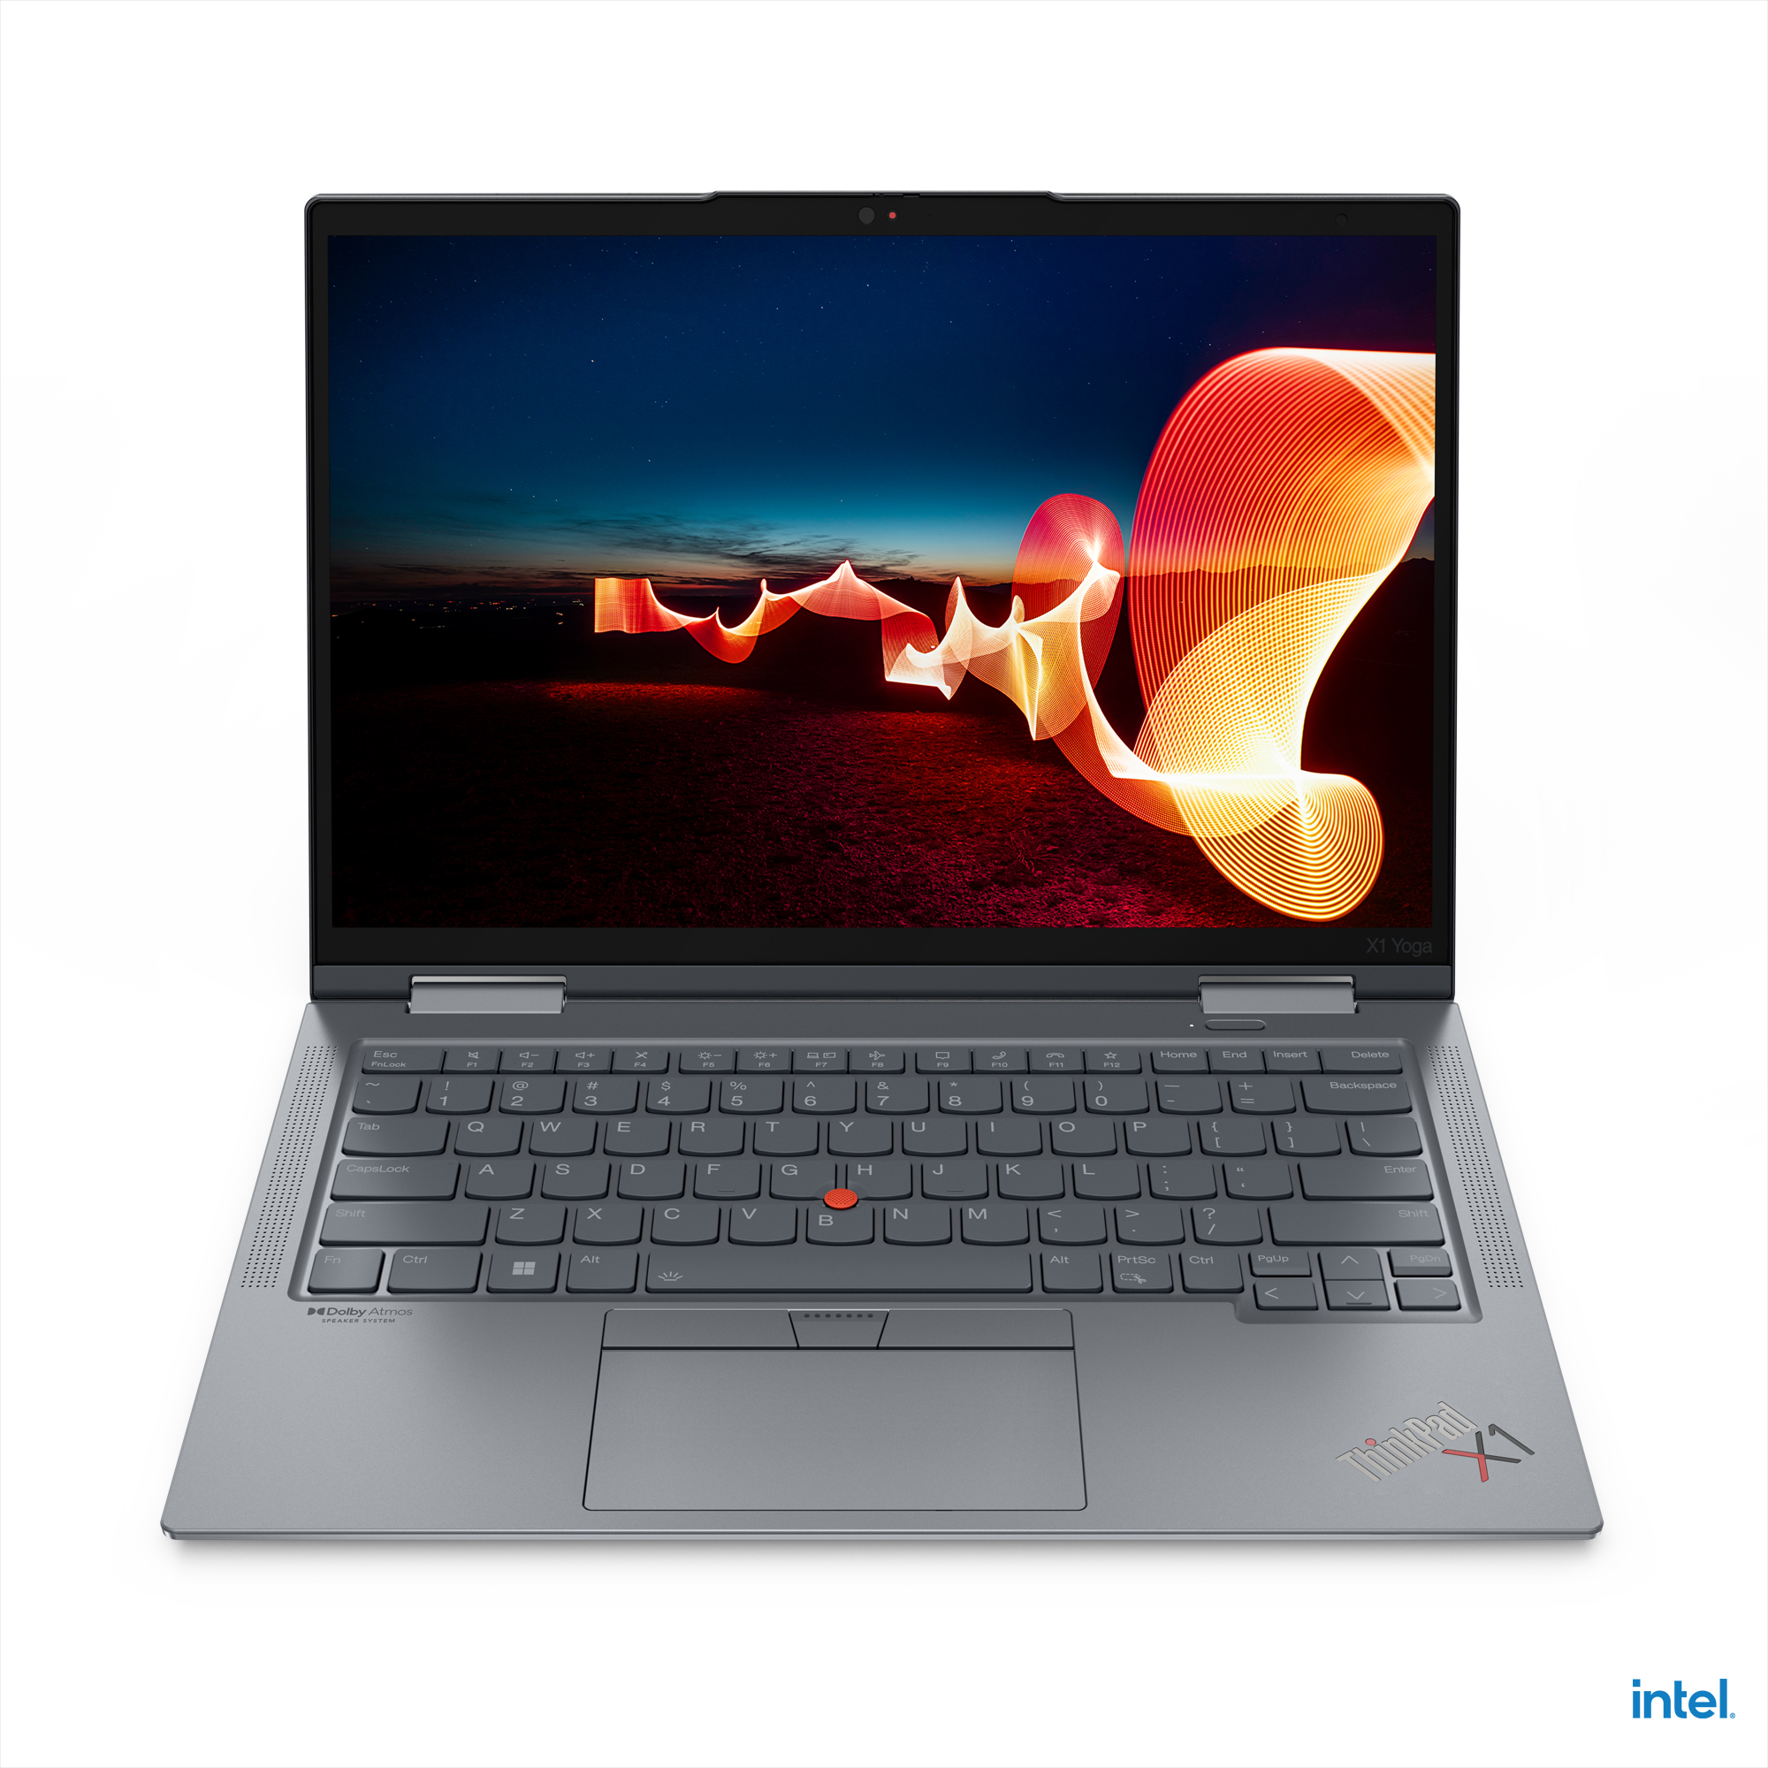
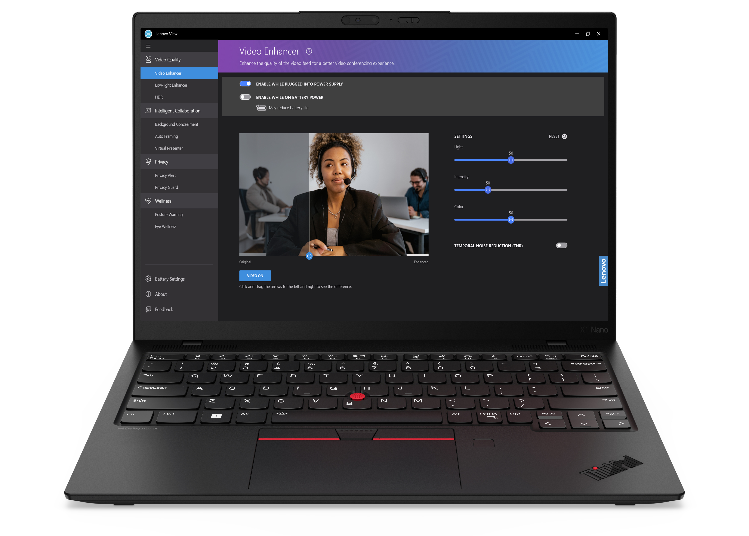
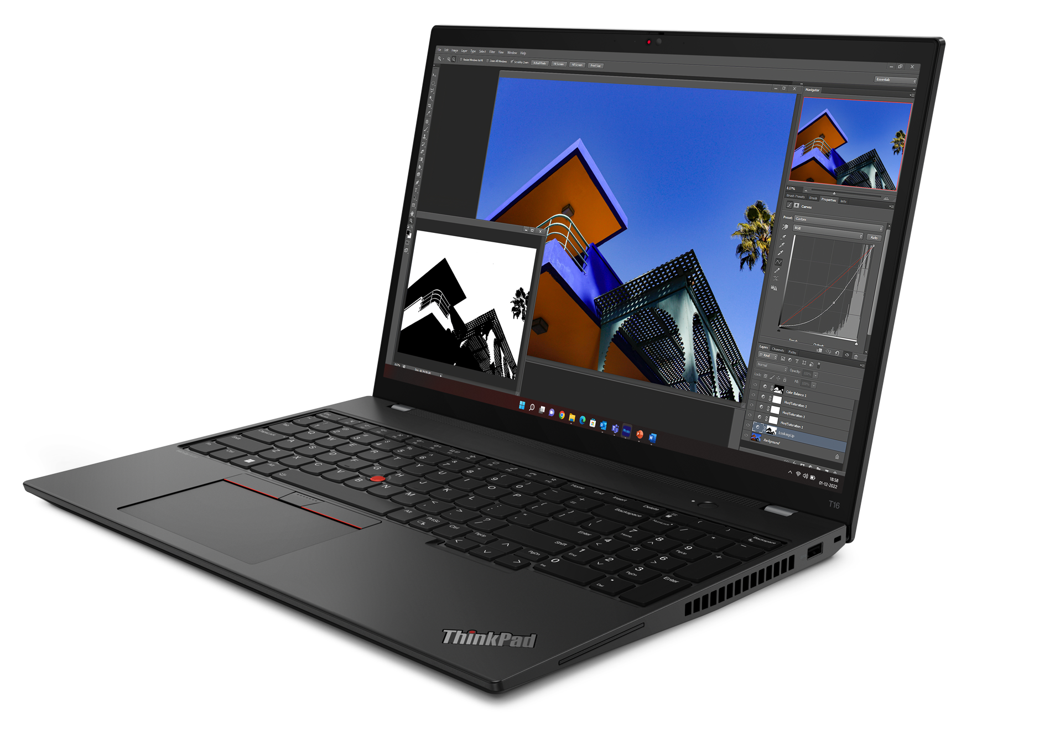
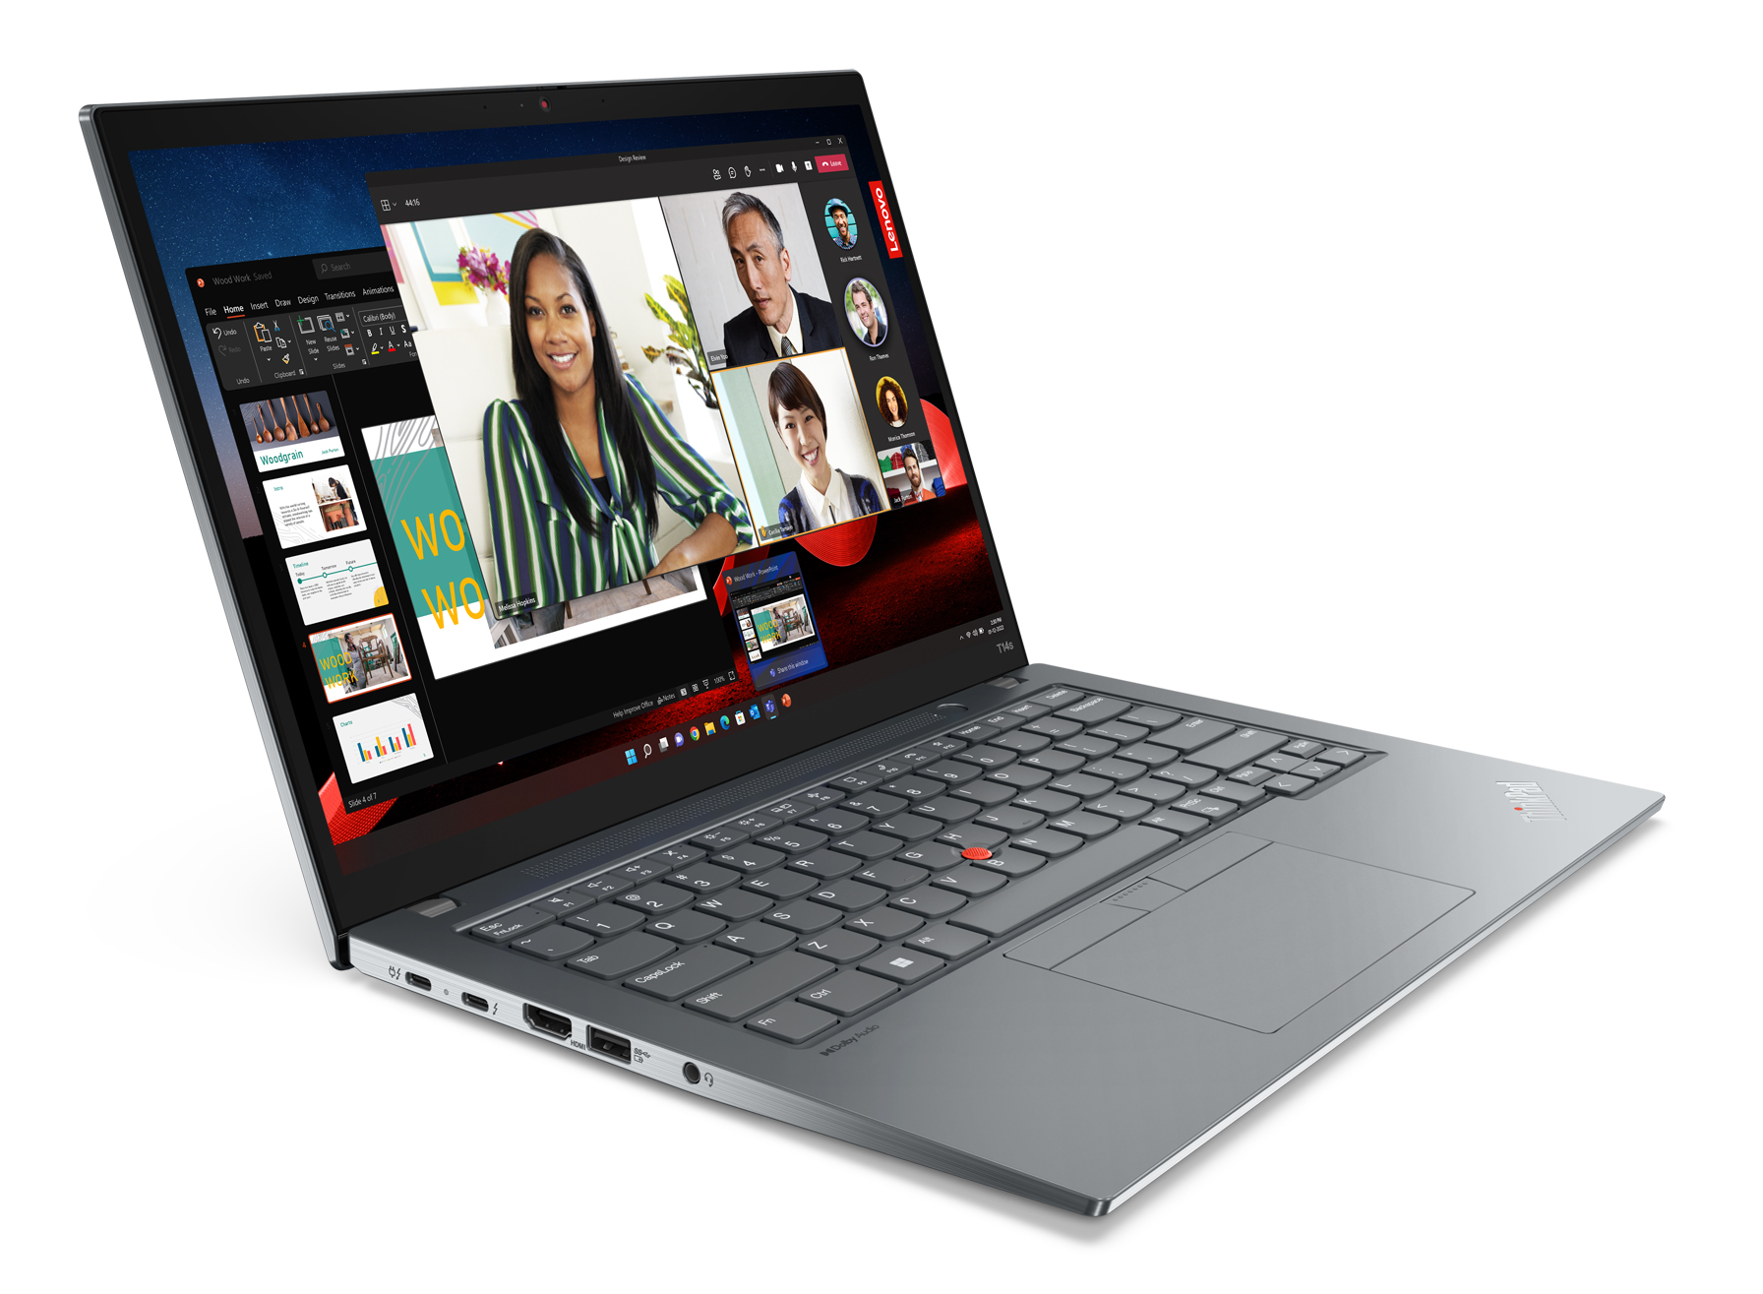
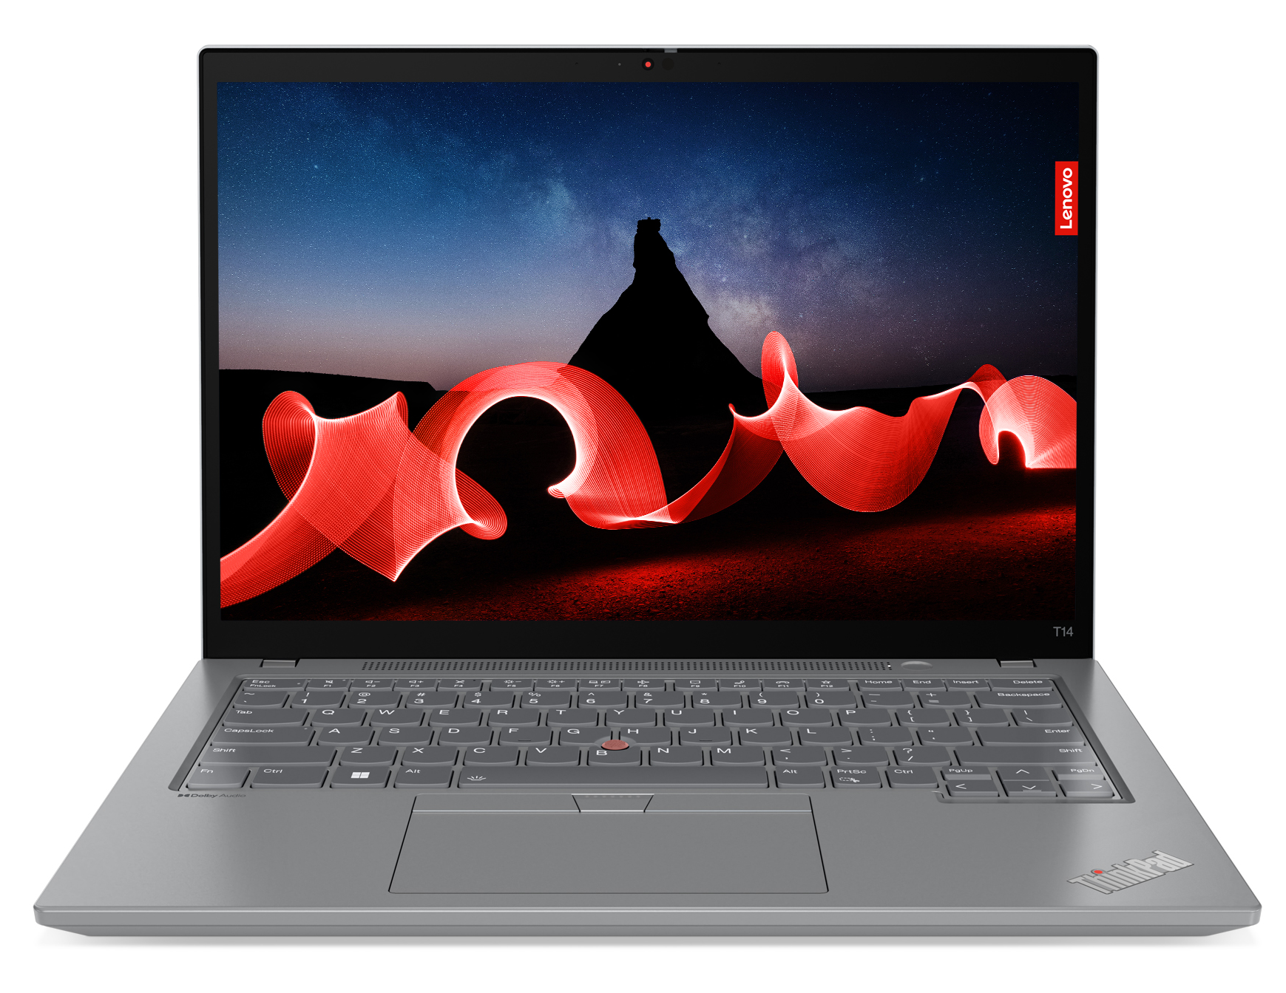
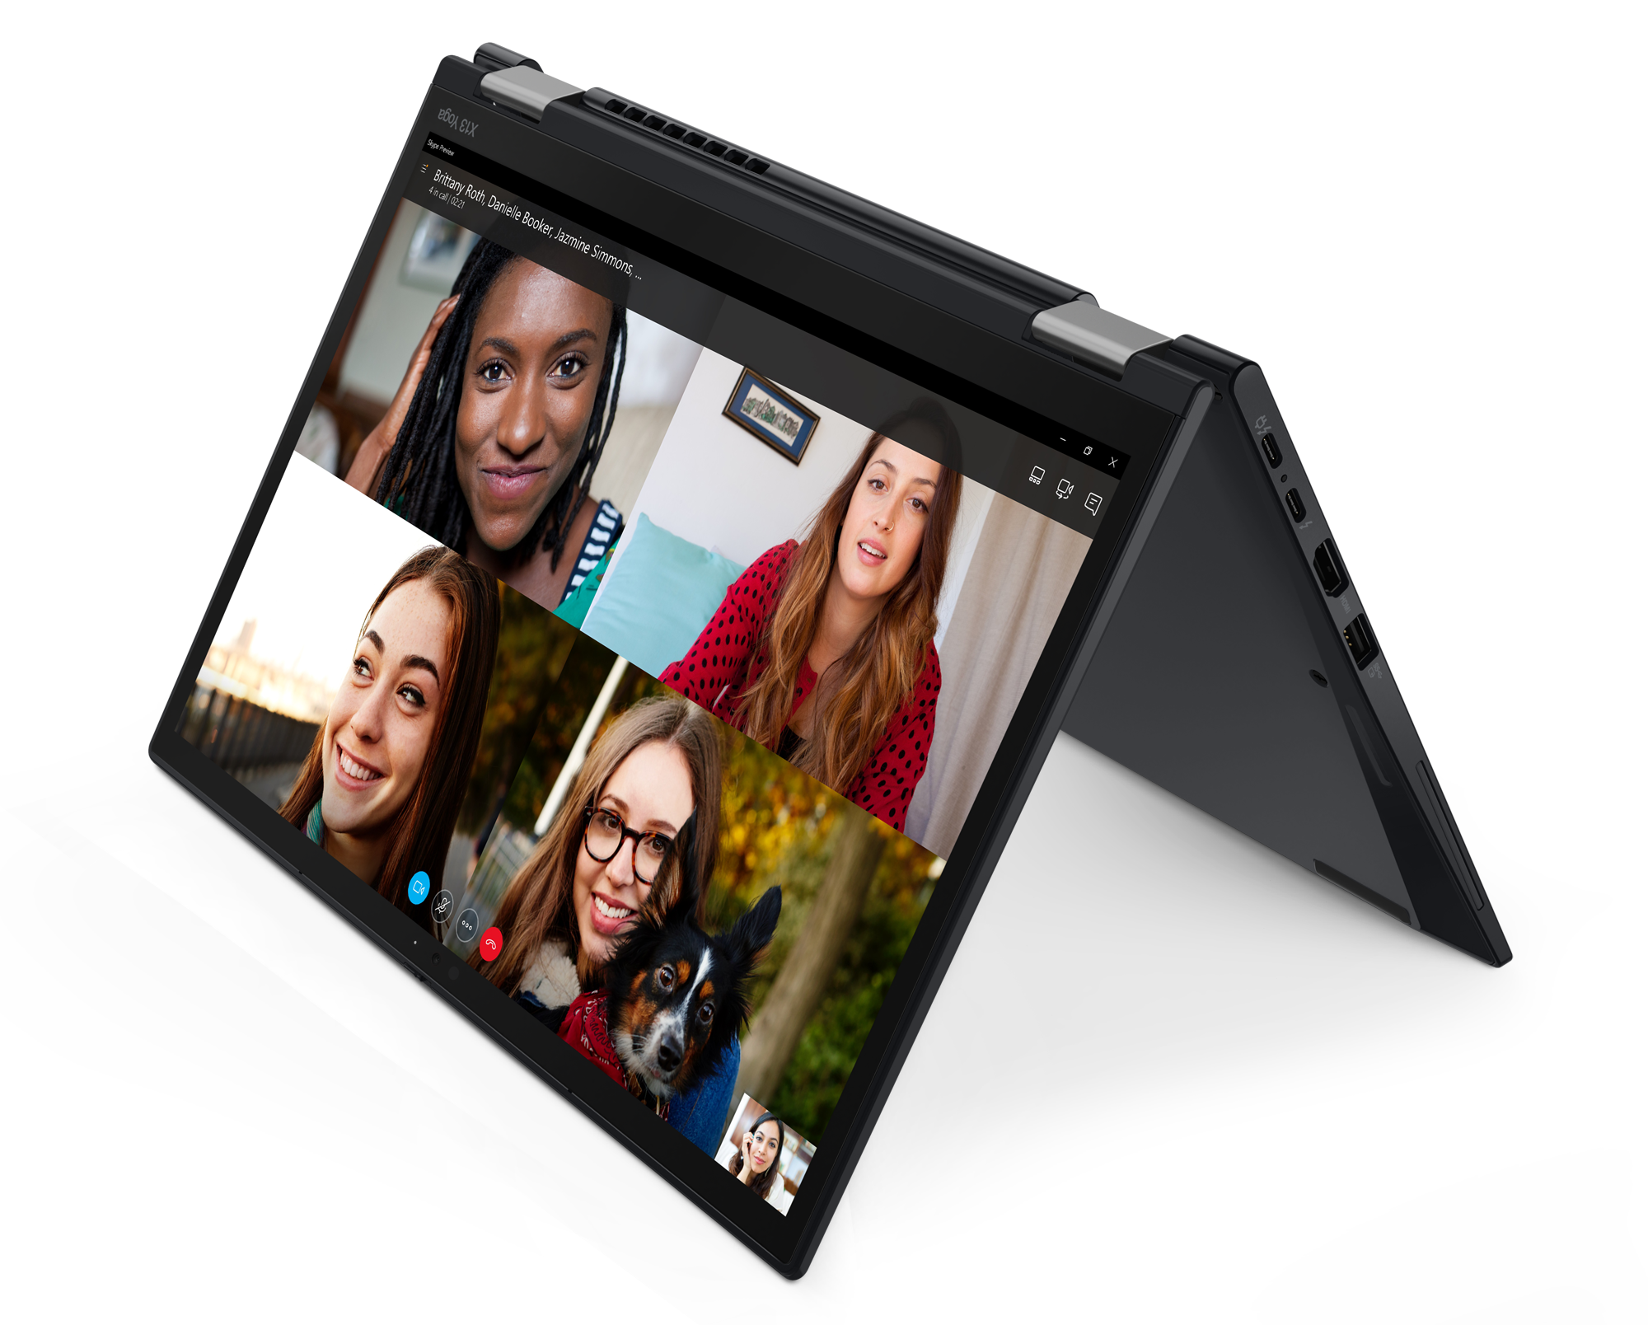
THINKPAD PREMIUM TOPSELLER NOTEBOOKS
[ 1 OF 4 ]
X1 Yoga 8th Gen
Z16 G1
X1 Carbon 11th Gen
X1 Nano Gen 3
X13 Yoga G3
T14s G4 (Intel/AMD)
T16 G2 (Intel/AMD)
T14 G4 (Intel/AMD)

Slide 5
THINKPAD PREMIUM TOPSELLER NOTEBOOKS
X & Z Series
[ 2 OF 4 ]
T14 G4 (Intel) | $2239 | $2369 | $2429 | $2579
 | $75 Rebate | $50 Rebate | $50 Rebate
 | 21HD0028US – Grey | 21HD0087US | 21HD002BUS - Grey | 21HD0088US
 | 21HD0028CA - Grey | 21HD0087CA | 21HD002BCA - Grey | 21HD0088CA
 | Core i5-1335U | Core i5-1345U Vpro | Core i7-1355U | Core i7-1365U Vpro
 | 16GB | 16GB | 16GB | 16GB
 | 512GB PCIe SSD | 512GB PCIe SSD | 512GB PCIe SSD | 512GB PCIe SSD
 | 14" FHD Touch + IR Cam | 14" FHD Touch + IR Cam | 14" FHD Touch + IR Cam | 14" FHD Touch + IR Cam
 | Camera, Backlit Keyboard, FPR, 2x2 + BT5.2, BT | Camera, Backlit Keyboard, FPR, 2x2 + BT5.2, BT | Camera, Backlit Keyboard, FPR, 2x2 + BT5.2, BT | Camera, Backlit Keyboard, FPR, 2x2 + BT5.2, BT
 | Integrated 39Wh | Integrated 39Wh | Integrated 39Wh | Integrated 39Wh
 | Windows 11 Pro | Windows 11 Pro | Windows 11 Pro | Windows 11 Pro
 | 3 Year Depot | 3 Year Depot | 3 Year Depot | 3 Year Depot
T14s G4 (Intel) | $2529 | $2769
 | $50 Rebate | $70 Rebate
 | 21F6001BUS - Grey | 21F6001HUS - Grey
 | 21F6001BCA- Grey | 21F6001HCA - Grey
 | Core i7-1355U | Core i7-1365U Vpro
 | 16GB (soldered) | 16GB (soldered)
 | 512GB PCIe SSD | 512GB PCIe SSD
 | 14” FHD | 14” FHD Touch
 | Camera, Backlit Keyboard, FPR, 2x2 AX WLAN, BT | Camera, Backlit Keyboard, FPR, 2x2 AX WLAN, BT
 | Integrated 57Wh | Integrated 57Wh
 | Windows 11 Pro | Windows 11 Pro
 | 3 Year Depot | 3 Year Depot
T16 G2 (Intel)
T16 G2 (Intel) | $2039 | $2269 | $2449 | $2599
 |  | $50 Rebate | $100 Rebate | $50 Rebate
 | 21HH001FUS | 21HH001JUS | 21HH001MUS - Grey | 21HH0053US
 | 21HH001FCA | 21HH001JCA | 21HH001MCA - Grey | 21HH0053CA
 | Core i5-1335U | Core i5-1335U | Core i7-1355U | Core i7-1365U Vpro
 | 16GB | 16GB | 16GB | 16GB
 | 256GB PCIe SSD | 512GB PCIe SSD | 512GB PCIe SSD | 512GB PCIe SSD
 | 16” FHD | 16" FHD + IR Cam | 16’ FHD + IR Cam | 16" FHD Touch + IR Cam
 | Camera, Backlit Keyboard, FPR, 2x2 AX WLAN, BT | Camera, Backlit Keyboard, FPR, 2x2 AX WLAN, BT | Camera, Backlit Keyboard, FPR, 2x2 AX WLAN, BT | Camera, Backlit Keyboard, FPR, 2x2 AX WLAN, BT
 | Integrated 52Wh | Integrated 52Wh | Integrated 52Wh | Integrated 52Wh
 | Windows 11 Pro | Windows 11 Pro | Windows 11 Pro | Windows 11 Pro
 | 3 Year Depot | 3 Year Depot | 3 Year Depot | 3 Year Depot
T14 G4 (Intel)
T14s G4 (Intel)

Slide 6
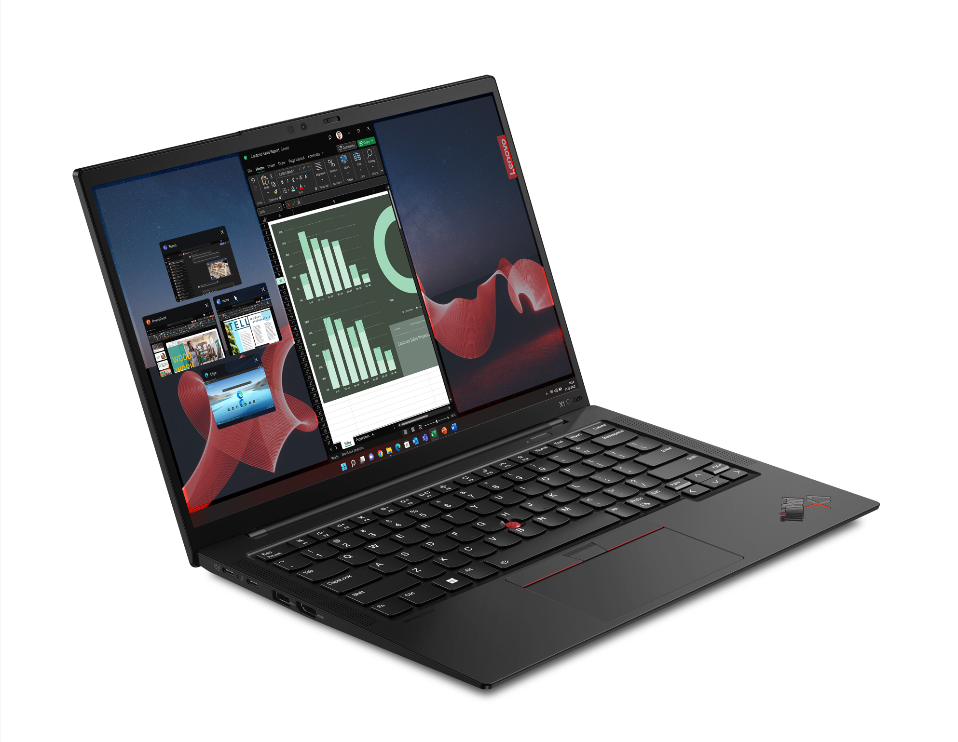
THINKPAD PREMIUM TOPSELLER NOTEBOOKS
X & Z Series
[ 3 OF 4 ]
X1 Carbon 11th Gen | $2339 | $2799 | $3169
 |  |  | $150 Rebate
 | 21HM000GUS | 21HM000JUS | 21HM000SUS
 | 21HM000GCA | 21HM000JCA | 21HM000SCA
 | Core i5-1335U | Core i7-1355U | Core i7-1365U Vpro
 | 16GB (soldered) | 16GB (soldered) | 32GB (soldered)
 | 256GB PCIe SSD | 512GB PCIe SSD | 512GB PCIe SSD
 | 14” FHD (400nit) | 14” FHD (400nit) + Touch + IR Cam | 14” FHD (400nit) + Touch + IR Cam
 | Camera, Backlit KBD, FPR, 2x2 AX WLAN, BT | Camera, Backlit KBD, FPR, 2x2 AX WLAN, BT | Camera, Backlit KBD, FPR, 2x2 AX WLAN, BT
 | Integrated 57Wh | Integrated 57Wh | Integrated 57Wh
 | Windows 11 Pro | Windows 11 Pro | Windows 11 Pro
 | 3 Year Premier Support, LSA | 3 Year Premier Support, LSA | 3 Year Premier Support, LSA
X1 Yoga 8th Gen | $2539 | $2959
 | $100 Rebate | $150 Rebate
 | 21HQ001NUS - Grey | 21HQ0007US – Grey
 | 21HQ001NCA - Grey | 21HQ0007CA – Grey
 | Core i5-1335U | Core i7-1355U
 | 16GB (soldered) | 16GB (soldered)
 | 256GB PCIe SSD | 512GB PCIe SSD
 | 14” FHD+ Touch | 14" FHD + Touch + IR Cam
 | Camera, Backlit KBD, FPR, 2x2 AX WLAN, BT, Pen | Camera, Backlit KBD, FPR, 2x2 AX WLAN, BT, Pen
 | Integrated 57Wh | Integrated 57Wh
 | Windows 11 Pro | Windows 11 Pro
 | 3 Year Premier Support, LSA | 3 Year Premier Support, LSA
X1 Carbon 11th Gen
X1 Yoga 8th Gen

Slide 7

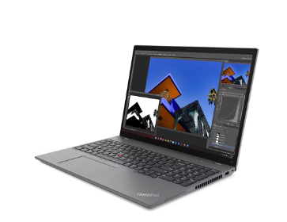

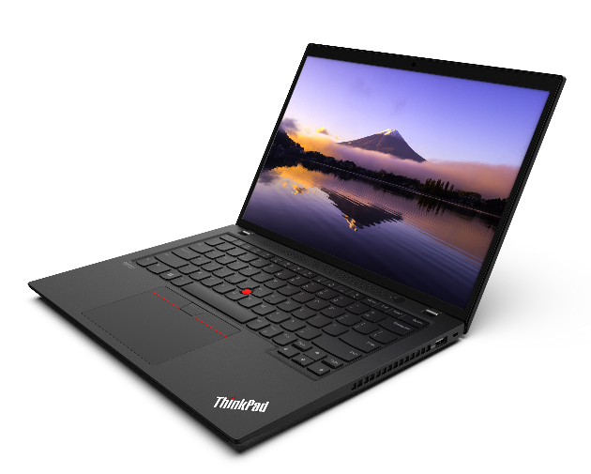
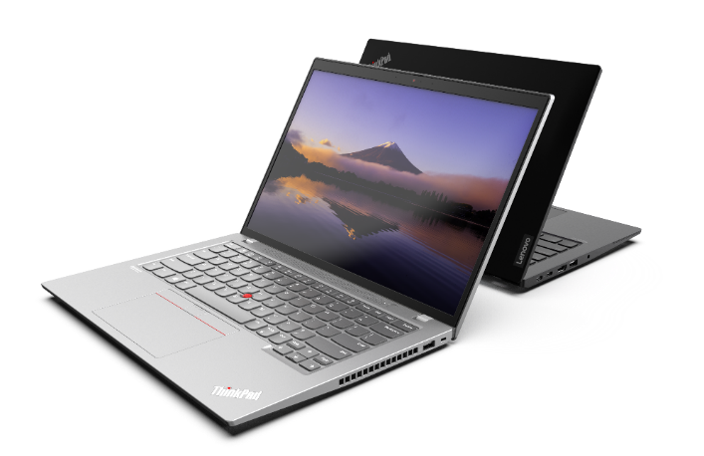
THINKPAD PREMIUM TOPSELLER NOTEBOOKS
T Series – AMD
[ 3 OF 4 ]
T14 G4 (AMD) | $1519 | $1649 | $1749
 |  |  | $125 Rebate
 | 21K30004US | 21K30005US | 21K30006US
 | 21K30004CA | 21K30005CA | 21K30006CA
 | Ryzen 5 Pro 7540U | Ryzen Pro 5 7540U | Ryzen 7 Pro 7840U
 | 16GB | 16GB | 16GB
 | 256GB PCIe SSD | 512GB PCIe SSD | 512GB PCIe SSD
 | 14" WUXGA | 14" WUXGA Touch + IR Cam | 14" FHD Touch + IR Cam
 | Camera, Backlit Keyboard, Wifi 6 2x2 + BT5.3 | FHD 1080p Camera, Backlit Keyboard, Wifi 6 2x2 + BT5.3 | 5MP Camera, Backlit Keyboard, WIFI 6, 2x2 + BT5.3
 | Integrated 39Wh | Integrated 39Wh | Integrated 39Wh
 | Windows 11 Pro | Windows 11 Pro | Windows 11 Pro
 | 3 Year Depot | 3 Year Depot | 3 Year Depot
T16 G4 (AMD) | $1549 | $1799
 | $75 Rebate | $150 Rebate
 | 21K70006US | 21K70008US
 | 21K70006CA | 21K70008CA
 | Ryzen 5 Pro 7540U | Ryzen Pro 7 7840U
 | 16GB | 16GB
 | 256GB PCIe SSD | 512GB PCIe SSD
 | 16" WUXGA | 16" WUXGA Touch + IR Cam
 | Camera, Backlit Keyboard, Wifi 6 2x2 + BT5.3 | 5MP Camera, Backlit Keyboard, Wifi 6 2x2 + BT5.3
 | Integrated 52Wh | Integrated 52Wh
 | Windows 11 Pro | Windows 11 Pro
 | 3 Year Depot | 3 Year Depot
T14s G4 (AMD) | $1619 | $1889
 |  | $75 Rebate
 | 21F8004KUS | 21F8004AUS
 | 21F8004KCA | 21F8004ACA
 | Ryzen 5 Pro 7540U | Ryzen Pro 7 7840U
 | 16GB | 16GB
 | 256GB PCIe SSD | 512GB PCIe SSD
 | 14" WUXGA | 14" WUXGA Touch + IR Cam
 | Camera, Backlit Keyboard, Wifi 6 2x2 + BT5.3 | 5MP Camera, Backlit Keyboard, Wifi 6 2x2 + BT5.3
 | Integrated 57Wh | Integrated 57Wh
 | Windows 11 Pro | Windows 11 Pro
 | 3 Year Depot | 3 Year Depot
T16 Gen 4
T14 Gen 4
T14s Gen 4

Slide 8
Lenovo Thinkpad Notebooks

Slide 9
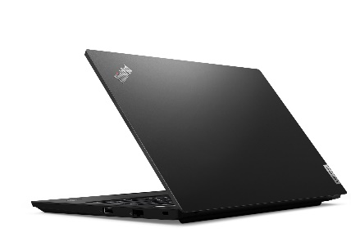
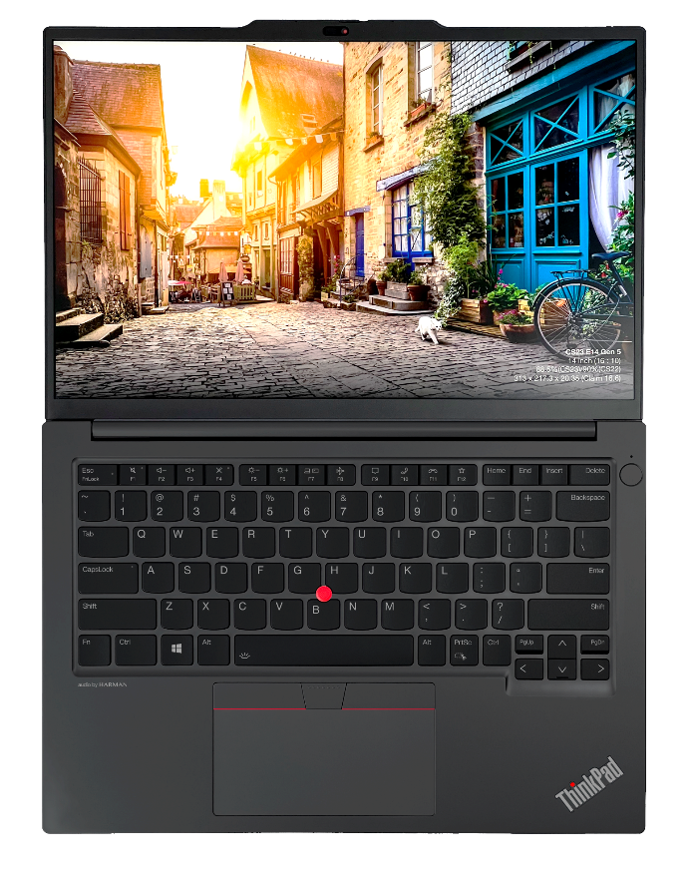
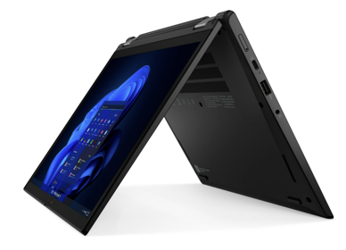
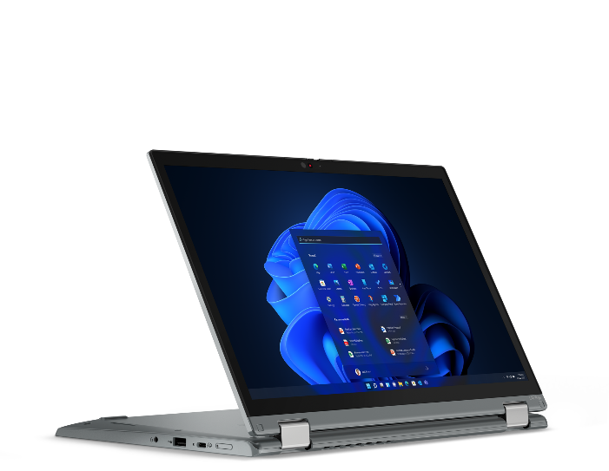
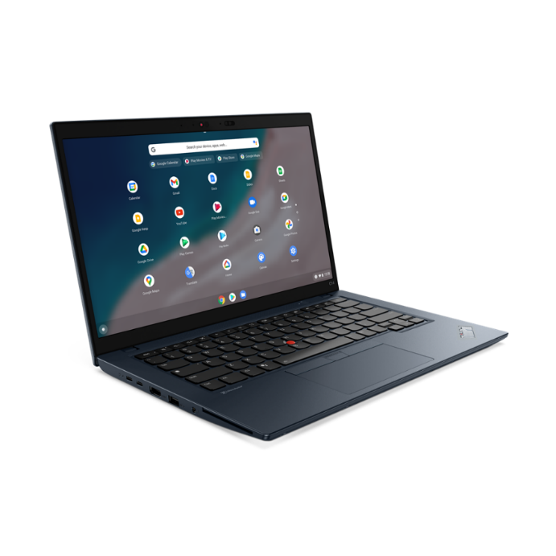
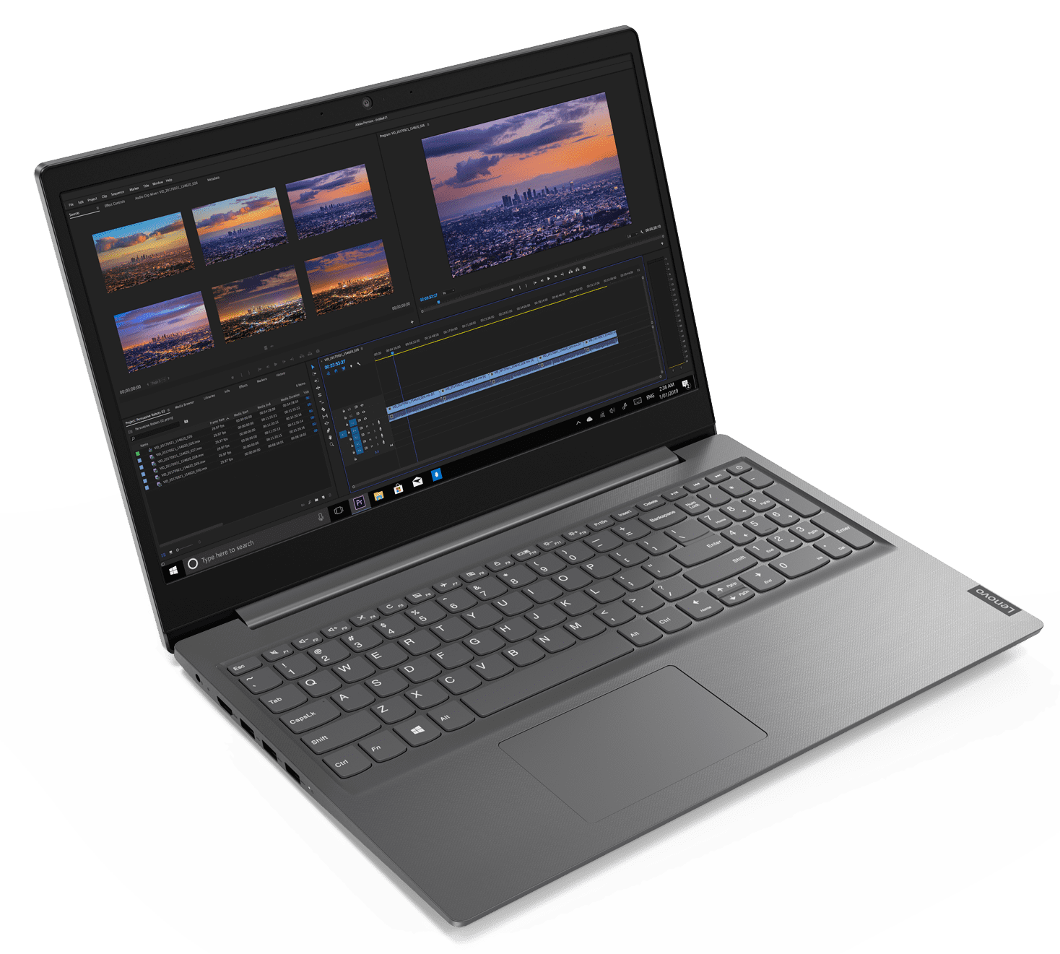
THINKPAD VELOCITY TOPSELLER NOTEBOOKS
[ 1 OF 5 ]
E14 (Intel / AMD)
E16 (Intel/AMD)
L13 Yoga
Lenovo V15
C14 (Chrome)

Slide 10

THINKPAD VELOCITY TOPSELLER NOTEBOOKS
E Series
[ 2 OF 5 ]
E14 G5 (Intel) | $1349 | $1499 | $1669
 | $25 Rebate | $50 Rebate | $75 Rebate
 | 21JK0084US | 21JK0052US | 21JK0053US
 | 21JK0084CA | 21JK0052CA | 21JK0053CA
 | Core i5-1335U | Core i5-1335U | Core i7-1355U
 | 2 x 8GB DIMM | 2 x 8GB DIMM | 2 x 8GB DIMM
 | 256GB SSD NVMe | 512GB SSD NVMe | 512GB SSD NVMe
 | 14” WUXGA IPS Anti-glare | 14” WUXGA IPS Anti-glare, Touch | 14” WUXGA IPS Anti-glare, Touch
 | FHD Camera w/Shutter, 2x2 AX WLAN, BT | FHD Camera w/Shutter, 2x2 AX WLAN, BT | FHD Camera w/Shutter, 2x2 AX WLAN, BT
 | Integrated 47Whr Battery | Integrated 47Whr Battery | Integrated 47Whr Battery
 | Win11 Pro | Win11 Pro | Win11 Pro
 | 1 Year Depot | 1 Year Depot | 1 Year Depot
E14 G5 (AMD) | $1079 | $1169
 | $50 Rebate | $75 Rebate
 | 21JR001QUS | 21JR001RUS
 | 21JR001QCA | 21JR001RCA
 | Ryzen 5 7530U | Ryzen 5 7530U
 | 1 x 8GB DIMM | 2 x 8GB DIMM
 | 256GB SSD NVMe | 256GB SSD NVMe
 | 14” WUXGA IPS Anti-glare | 14” WUXGA IPS Anti-glare
 | FHD Camera w/Shutter, 2x2 AX WLAN, BT | FHD Camera w/Shutter, 2x2 AX WLAN, BT
 | Integrated 47Whr Battery | Integrated 47Whr Battery
 | Win11 Pro | Win11 Pro
 | 1 Year Depot | 1 Year Depot
E14 (Intel/AMD)
E16 G1 (AMD) | $1119 | $1199 | $1469
 | $50 Rebate | $75 Rebate | $75 Rebate
 | 21JT001PUS | 21JT001BUS | 21JT001QUS
 | 21JT001PCA | 21JT001BCA | 21JT001QCA
 | Ryzen 5 7530U | Ryzen 5 7530U | Ryzen 7 7730U
 | 1 x 8GB DIMM | 2 x 8GB DIMM | 2 x 8GB DIMM
 | 256GB SSD NVMe | 256GB SSD NVMe | 512GB SSD NVMe
 | 16” WUXGA IPS Anti-glare | 16” WUXGA IPS Anti-glare | 16” WUXGA IPS Anti-glare
 | FHD Camera w/Shutter, 2x2 AX WLAN, BT | FHD Camera w/Shutter, 2x2 AX WLAN, BT | FHD Camera w/Shutter, 2x2 AX WLAN, BT
 | Integrated 47Whr Battery | Integrated 47Whr Battery | Integrated 47Whr Battery
 | Win11 Pro | Win11 Pro | Win11 Pro
 | 1 Year Depot | 1 Year Depot | 1 Year Depot
E16 G1 (Intel) | $1379 | $1619
 | $75 Rebate | $120 Rebate
 | 21JN003YUS | 21JN0073US
 | 21JN003YCA | 21JN0073CA
 | Core i5-1335U | Core i7-1355U
 | 2 x 8GB DIMM | 2 x 8GB DIMM
 | 256GB SSD NVMe | 512GB SSD NVMe
 | 16” WUXGA IPS Anti-glare | 16” WUXGA IPS Anti-glare
 | FHD Camera w/Shutter, 2x2 AX WLAN, BT | FHD Camera w/Shutter, 2x2 AX WLAN, BT
 | Integrated 47Whr Battery | Integrated 47Whr Battery
 | Win11 Pro | Win11 Pro
 | 1 Year Depot | 1 Year Depot
E16 (Intel/AMD)

Slide 11
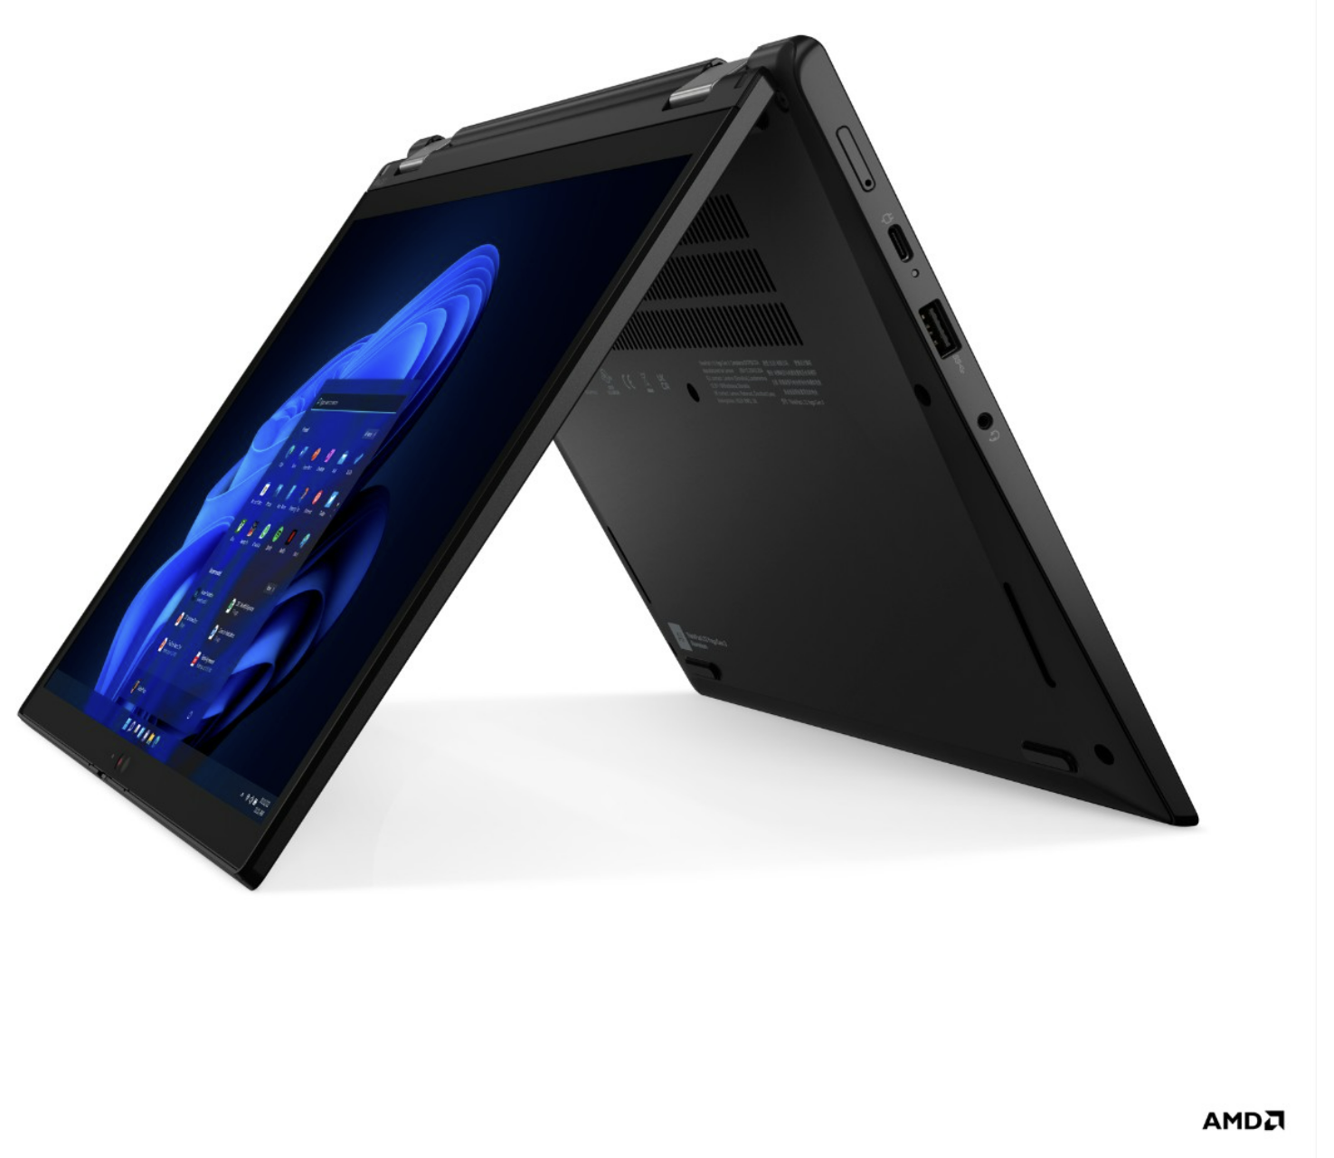

THINKPAD VELOCITY TOPSELLER NOTEBOOKS
L13 Yoga / V Series / Enterprise Chrome
[ 3 OF 5 ]
L13 G4 Yoga (Intel) | $2189 $75 Rebate
 | 21FJ002DUS
 | 21FJ002DCA
 | Core i7-1355U
 | 16GB DIMM
 | 512GB SSD NVMe
 | 13.3” WUXGA IPS Anti-glare Touch
 | IR Camera w/Shutter, FPR, 2x2 AX WLAN, BT, Backlit Keyboard, Black
 | Integrated 46Whr Battery
 | Win11 Pro
 | 3 Year Depot
Lenovo V14 G4 – AMD | $739
 | 82YX000BUS
 | AMD R5 5500U
 | 1 x 8 GB (soldered)
 | 256 SSD M.2 NVMe
 | 14” FHD TN Anti-glare
 | HD Camera w/Shutter, 2x2 AX WLAN, BT
 | Integrated 38Whr Battery
 | Win 11 Pro
 | 1 Year Depot
Lenovo V15 G4 - AMD | $739
 | 83CR0005US
 | 83CR0006CA
 | AMD R5 5500U
 | 1 x 8 GB (soldered)
 | 256 SSD M.2 NVMe
 | 15.6” FHD TN Anti-glare
 | HD Camera w/Shutter, 2x2 AX WLAN, BT
 | Integrated 38Whr Battery
 | Win 11 Pro
 | 1 Year Depot
L13 Yoga
C14 Gen1 (Chrome) | $1449
 | 21C9000HUS
 | 21C9000HCZ
 | Core i5-1245U
 | 8GB DIMM
 | 256GB SSD NVMe
 | 14” FHD IPS Anti-glare
 | Camera w/Shutter, FPR, 2x2 AX WLAN, BT, Backlit Keyboard, Abyss Blue
 | Integrated 57Whr Battery
 | ChromeOS
 | 1 Year Depot
Lenovo V15 G4 - Intel | $969
 | 83A10024US
 | 83A10025CA
 | Intel Core i5-1335U
 | 1 x 8GB DIMM
 | 256 SSD M.2 NVMe
 | 15.6” FHD TN Anti-glare
 | HD Camera w/Shutter, 2x2 AX WLAN, BT
 | Integrated 38Whr Battery
 | Win 11 Pro
 | 1 Year Depot
Lenovo V14 G4 - Intel | $969
 | 83A00023US
 | Intel Core i5-1335U
 | 1 x 8GB DIMM
 | 256 SSD M.2 NVMe
 | 14” FHD TN Anti-glare
 | HD Camera w/Shutter, 2x2 AX WLAN, BT
 | Integrated 38Whr Battery
 | Win 11 Pro
 | 1 Year Depot
Lenovo V15
C14 (Chrome)

Slide 12
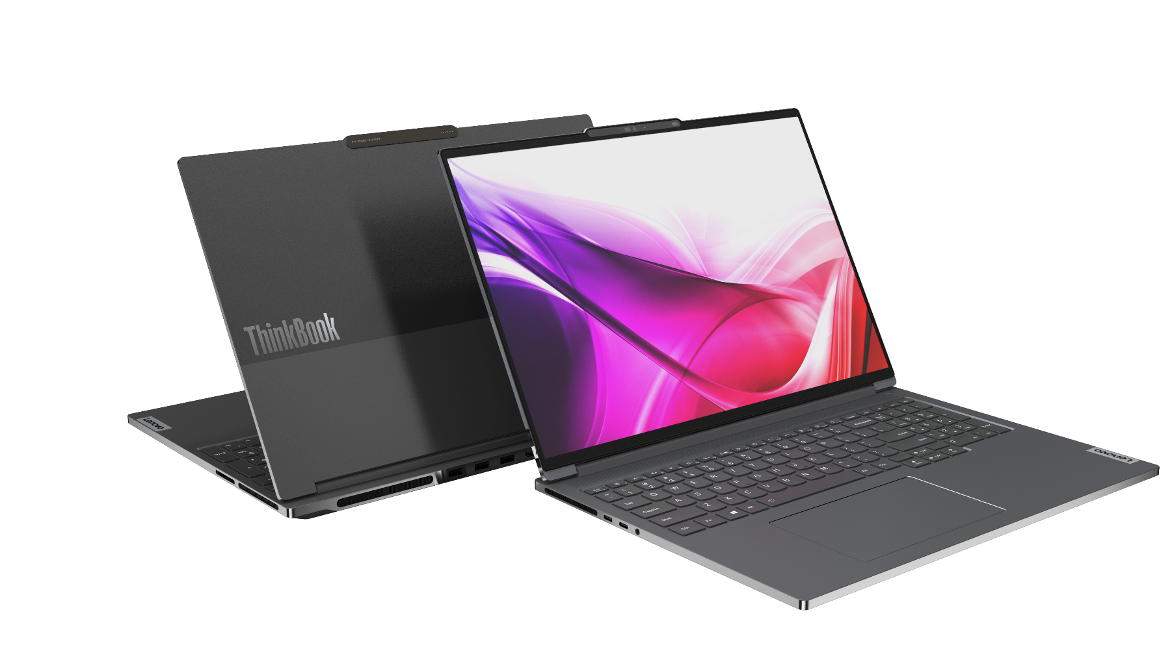
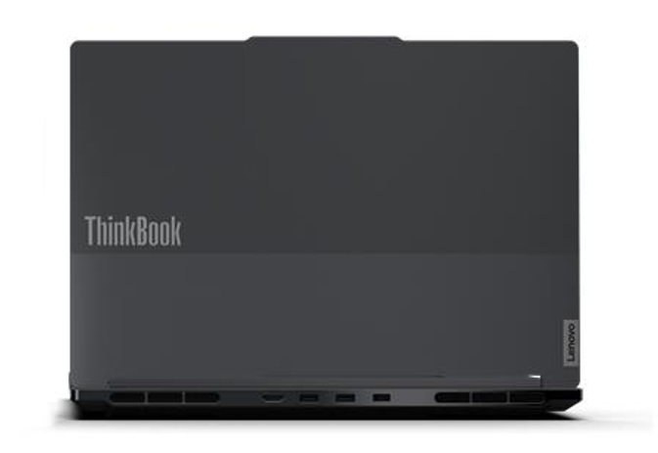
LENOVO TOPSELLER
ThinkBook
[ 4 OF 5 ]
ThinkBook 14 G6 (Intel) | $1279 | $1539
 |  | $75 Rebate
 | 21KG0005US | 21KG000FUS
 | 21KG0006CA | 21KG000GCA
 | Core i5-1335U | i7-1355U
 | 2 x 8GB DIMM | 2 x 8GB DIMM
 | 256GB SSD NVMe | 512GB SSD NVMe
 | 14” WUXGA IPS Anti-glare | 14” WUXGA IPS Anti-glare Touch
 | FHD Camera w/Shutter, 2x2 AX WLAN, BT, Backlit Keyboard, Aluminum | FHD Camera w/Shutter, 2x2 AX WLAN, BT, Backlit Keyboard, Aluminum
 | Integrated 45Whr Battery | Integrated 45Whr Battery
 | Win11 Pro | Win11 Pro
 | 1 Year Depot | 1 Year Depot
ThinkBook 14 G6 (AMD) | $1209 | $1339
 | 21KJ0009US | 21KJ000EUS
 | 21KJ000ACA | 21KJ000FCA
 | Ryzen 5 7530U | Ryzen 7 7730U
 | 2 x 8GB DIMM | 2 x 8GB DIMM
 | 512GB SSD NVMe | 512GB SSD NVMe
 | 14” WUXGA IPS Anti-glare Touch | 14” WUXGA IPS Anti-glare Touch
 | FHD Camera w/Shutter, 2x2 AX WLAN, BT, Backlit Keyboard, Aluminum | FHD Camera w/Shutter, 2x2 AX WLAN, BT, Backlit Keyboard, Aluminum
 | Integrated 45Whr Battery | Integrated 45Whr Battery
 | Win11 Pro | Win11 Pro
 | 1 Year Depot | 1 Year Depot
ThinkBook 16 G6 Intel | $1279 | $1389 | $1559
 |  | $50 Rebate
 | 21KH0005US | 21KH000AUS | 21KH000FUS
 | 21KH0006CA | 21KH000BCA | 21KH000GCA
 | Core i5-1335U | Core i5-1335U | i7-1355U
 | 2 x 8GB DIMM | 2 x 8GB DIMM | 2 x 8GB DIMM
 | 256GB SSD NVMe | 512GB SSD NVMe | 512GB SSD NVMe
 | 16” WUXGA IPS Anti-glare | 16” WUXGA IPS Anti-glare Touch | 16” WUXGA IPS Anti-glare Touch
 | FHD Camera w/Shutter, 2x2 AX WLAN, BT, Backlit Keyboard, Aluminum | FHD Camera w/Shutter, 2x2 AX WLAN, BT, Backlit Keyboard, Aluminum | FHD Camera w/Shutter, 2x2 AX WLAN, BT, Backlit Keyboard, Aluminum
 | Integrated 45Whr Battery | Integrated 45Whr Battery | Integrated 45Whr Battery
 | Win11 Pro | Win11 Pro | Win11 Pro
 | 1 Year Depot | 1 Year Depot | 1 Year Depot
ThinkBook 16 G6 AMD | $1239 | $1349
 | $50 Rebate | $50 Rebate
 | 21KK0009US | 21KK000EUS
 | 21KK000ACA | 21KK000FCA
 | Ryzen 5 7530U | Ryzen 7 7730U
 | 2 x 8GB DIMM | 2 x 8GB DIMM
 | 512GB SSD NVMe | 512GB SSD NVMe
 | 16” WUXGA IPS Anti-glare Touch | 16” WUXGA IPS Anti-glare Touch
 | FHD Camera w/Shutter, 2x2 AX WLAN, BT, Backlit Keyboard, Aluminum | FHD Camera w/Shutter, 2x2 AX WLAN, BT, Backlit Keyboard, Aluminum
 | Integrated 45Whr Battery | Integrated 45Whr Battery
 | Win11 Pro | Win11 Pro
 | 1 Year Depot | 1 Year Depot
ThinkBook 14 (Intel / AMD)
ThinkBook 16 (Intel / AMD)

Slide 13
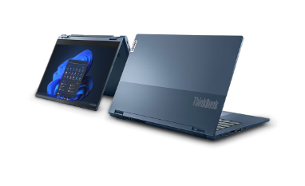
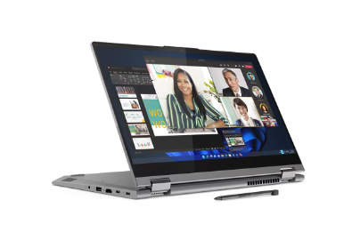
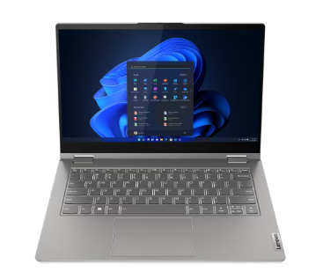
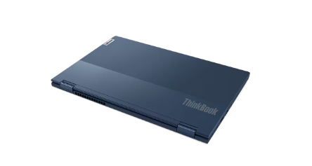
LENOVO TOPSELLER
ThinkBook
[ 5 OF 5 ]
ThinkBook 14s Yoga G3 | $1499 | $1729
 |  | $100 Rebate
 | 21JG0019US | 21JG001FUS
 | 21JG001ACA | 21JG001GCA
 | Core i5-1335U | Core i7-1355U
 | 8GB DIMM + 8GB DIMM | 8GB DIMM + 8GB DIMM
 | 256GB SSD NVMe | 512GB SSD NVMe
 | 14” FHD IPS Touch sRGB | 14” FHD IPS Touch sRGB
 | Camera w/Shutter, FPR, 2x2 AX WLAN, BT, Aluminum, Backlit Keyboard | Camera w/Shutter, FPR, 2x2 AX WLAN, BT, Aluminum, Backlit Keyboard
 | Integrated 60Whr Battery | Integrated 60Whr Battery
 | Win11 Pro | Win11 Pro
 | 1 Year Depot | 1 Year Depot

Slide 14
ThinkCentre & Lenovo Desktops

Slide 15
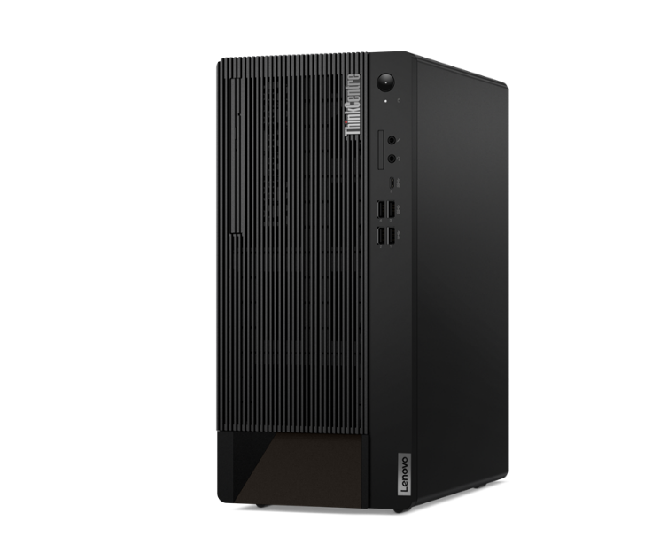
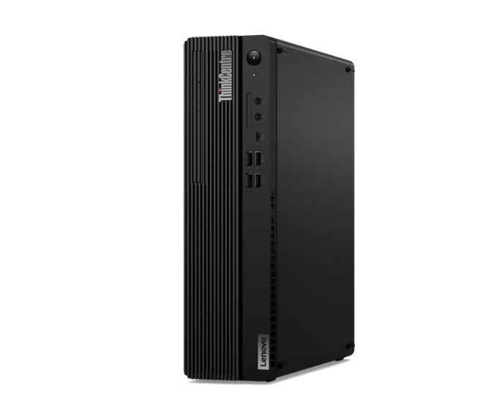
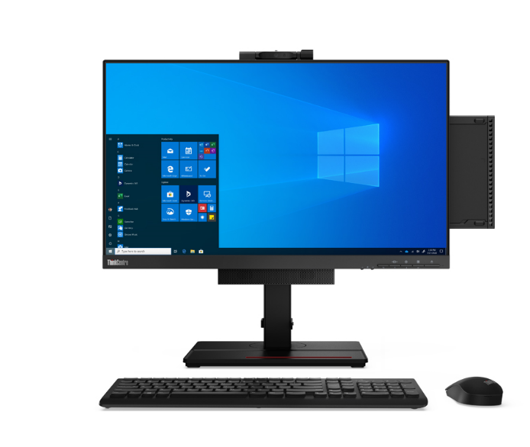
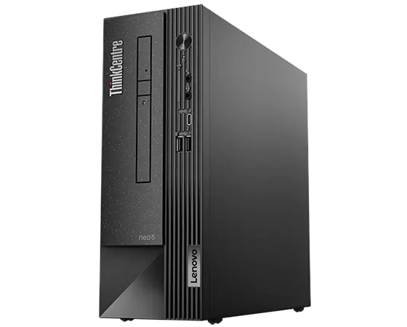
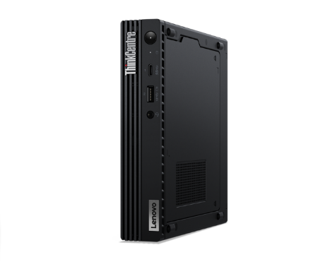
LENOVO TOPSELLER
ThinkCentre & Lenovo Desktops
[ 1 OF 7 ]
ThinkCentre M75q Gen 2 Tiny (Pictured with optional Tiny-in-One)
ThinkCentre Tower
(M70t/M80t/M90t)
ThinkCentre
Small Form Factor
(M70s/M75s/M80s/M90s)
ThinkCentre Neo Small Form Factor
(Neo50s)
ThinkCentre Tiny
(Neo 50q/M70q/M75q/M80q/M90q)

Slide 16

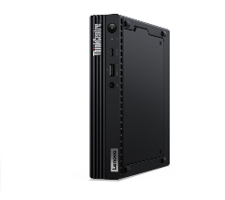
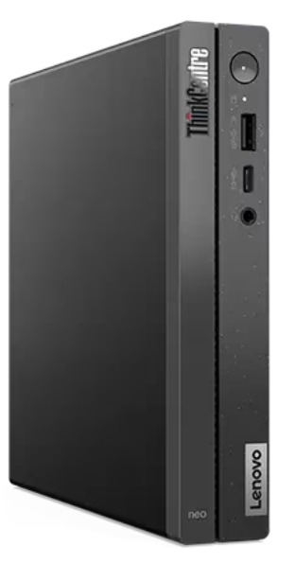
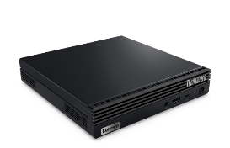
LENOVO TOPSELLER
ThinkCentre Tiny AMD & Intel Desktops
[ 2 OF 7 ]
M75q Tiny Gen 2 | $1049 | $1149
 | $25 Rebate | $25 Rebate
 | 11JN002PUS | 11JN0089US
 | Ryzen 5 PRO 5650GE | Ryzen 5 PRO 5650GE
 | 8GB Memory | 16GB Memory
 | 256GB SSD M.2 PCIe | 256GB SSD M.2 PCIe
 | Win11 Pro 64 | Win11 Pro 64
 | 3 Year Onsite | 3 Year Onsite
$1349
$50 Rebate
11JN002RUS
Ryzen 7 PRO 5750GE
16GB Memory
512GB SS M.2 PCIe
Win11 Pro 64
3 Year Onsite
[ 2 OF 3 ]
ThinkCentre M75q Gen 2 Tiny (Pictured with Tiny-in-One)
Neo 50q Gen 4 | $969 | $1049
 | 12LN000CUS | 12LN000BUS
 | 12LN000CCA | 12LN000BCA
 | Core i5-13420H | Core i5-13420H
 | 8GB DDR4 2666MHz | 16GB DDR4 2666MHz
 | 256GB M.2 SSD | 256GB M.2 SSD
 | 2x2 AC Wi-Fi + BT 5.2 | 2x2 AC Wi-Fi + BT 5.2
 | DP + HDMI | DP + HDMI
 | Win11 Pro 64 | Win11 Pro 64
 | 1 Year Onsite | 1 Year Onsite
Neo 50q Gen 4

Slide 17
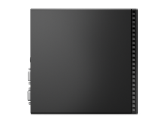
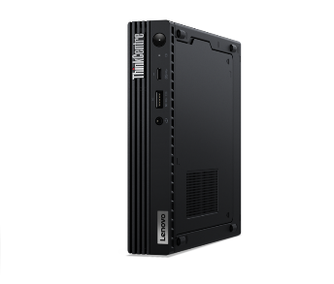
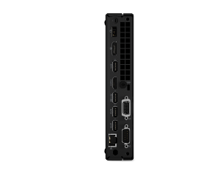
LENOVO TOPSELLER
ThinkCentre Tiny
[ 3 OF 7 ]
M70q Tiny Gen 3 | $1199 | $1259 | $1309 | $1,649
 | $50 Rebate | $75 Rebate |  | $25 Rebate
 | 11T3000BUS | 11T300C0US | 11T300C9US | 11T3000RUS
 | 11T3000BCA | 11T300C0CA | 11T300C9CA | 11T3000RCA
 | Core i5-12400T | Core i5-12400T | Core i5-12400T | Core i7-12700T
 | 8GB DDR4 2666MHz | 16GB DDR4 2666MHz | 16GB DDR4 2666MHz | 16GB DDR4 2666MHz
 | 256GB SSD M.2 PCIe | 256GB SSD M.2 PCIe | 512GB SSD M.2 PCIe | 256GB SSD M.2 PCIe
 | Win11 Pro 64 | Win11 Pro 64 | Win11 Pro 64 | Win11 Pro 64 Win10 DG
 | 3 Year Onsite | 3 Year Onsite | 3 Year Onsite | 3 Year Onsite
[ 2 OF 3 ]
ThinkCentre M70q Tiny
M90q Tiny Gen 3 | $1,579
 | $50 Rebate
 | 11U50069US
 | 11U50069CA
 | Core i5-12500
 | 16GB DDR4 2666MHz
 | 256GB SSD M.2 PCIe
 | Win11 Pro 64
 | 3 Year Onsite
M80q Tiny Gen 3 | $1,419 | $1,849
 | $25 Rebate | $50 Rebate
 | 11U10054US | 11U1000YUS
 |  | 11U1000YCA
 | Core i5-12500T | Core i7-12700T
 | 16GB DDR4 2666MHz | 16GB DDR4 2666MHz
 | 256GB SSD M.2 PCIe | 512GB SSD M.2 PCIe
 | Win11 Pro 64 | Win11 Pro 64
 | 3 Year Onsite | 3 Year Onsite
ThinkCentre M80q Tiny
ThinkCentre M90q Tiny

Slide 18
LENOVO TOPSELLER
ThinkCentre Small Form Factor Desktops
[ 4 OF 7 ]
Neo 50s Gen 4 | $1049 | $1109 | M75s Gen 2 ACN SFF | $1089 | $1,419
 |  | $25 Rebate |  | $25 Rebate
 | 12JF0000US | 12JF0002US |  | 11R8001XUS | 11R8004GUS
 | 12JF0000CA | 12JF0002CA
 | Core i5-13400 | Core i5-13400 |  | Ryzen 5 5650G | Ryzen 7 5750G
 | 8GB DDR4 2666MHz | 8GB DDR4 2666MHz |  | 8GB DDR4-3200 | 16GB DDR4-3200
 | 128GB SSD M.2 PCIe | 256GB SSD M.2 PCIe |  | 256GB SSD M.2 PCIe | 256GB SSD M.2 PCIe
 | DVD RW | DVD RW |  | Radeon Graphics | Radeon Graphics
 | VGA + DisplayPort | VGA + DisplayPort |  | Win11 Pro 64 | Win11 Pro 64
 | Win11 Pro 64 | Win11 Pro 64 |  | 3 Year Onsite | 3 Year Onsite
 | 3 Year Onsite | 3 Year Onsite
M70s SFF Gen 3 | $1319 | $1,749
 | $25 Rebate | $25 Rebate
 | 11T8001GUS | 11T8001CUS
 | 11T8001GCA | 11T8001CCA
 | Core i5-12500 | Core i7-12700
 | 16GB DDR4 2666MHz | 16GB DDR4 2933MHz
 | 256GB SSD M.2 PCIe | 512GB SSD M.2 PCIe
 | DVD RW | DVD RW
 | 2 Display Ports | 2 Display Ports
 | Win11 Pro 64 | Win11 Pro 64
 | 3 Year Onsite | 3 Year Onsite
M80s SFF Gen 3
$1,939
$50 Rebate
11TG000AUS
11TG000ACA
Core i7-12700
16GB DDR4 2933MHz
512GB SSD M.2 PCIe
DVD RW
2 Display Ports
Win11 Pro 64
3 Year Onsite
[ 2 OF 3 ]

Slide 19
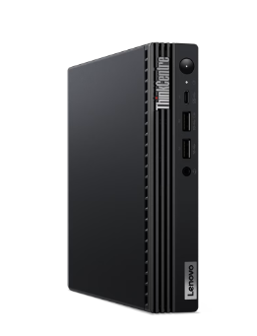
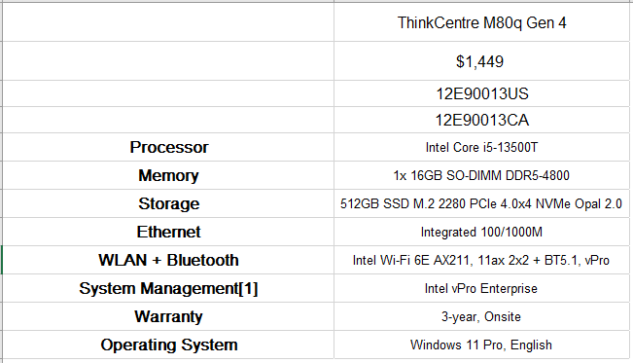
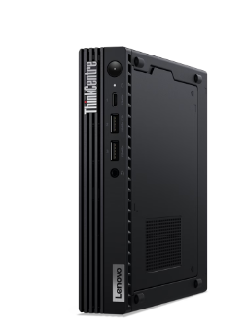
LENOVO TOPSELLER
ThinkCentre Mini Tower Desktops
[ 5 OF 7 ]
M70q Gen 4
M80q Gen 4

Slide 20
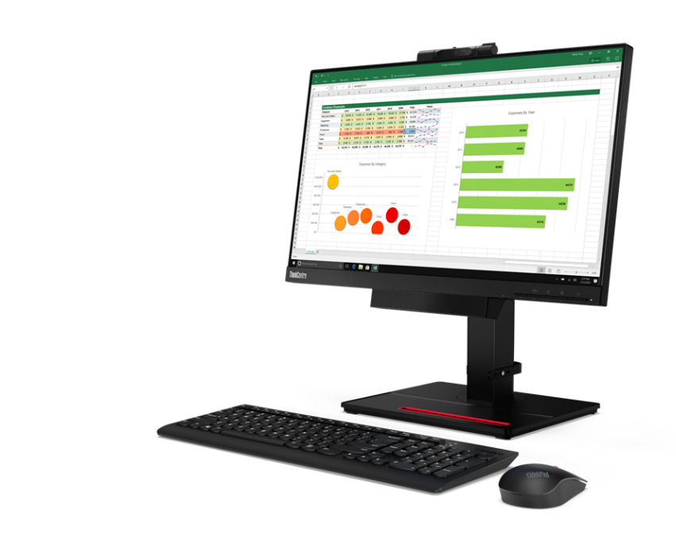

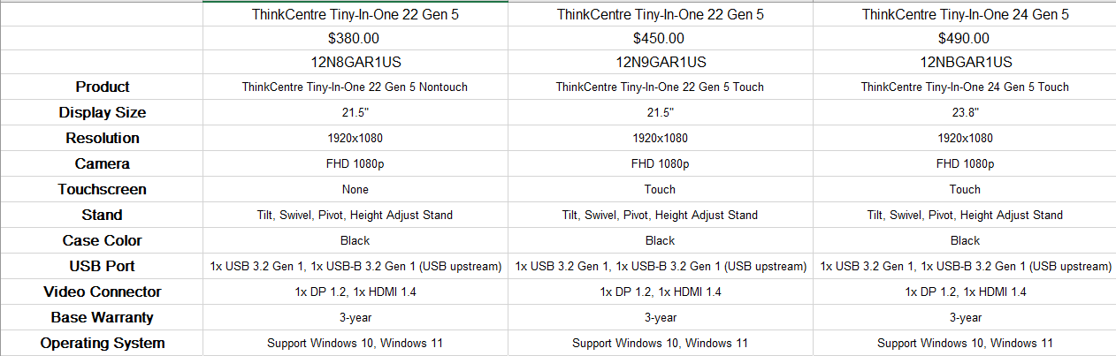
LENOVO TOPSELLER
ThinkCentre Tiny-in-One Monitors
[ 6 OF 7 ]
TINY-IN-ONE Gen 5
Price is Monitor Only.
ThinkCentre Tiny (Pictured) Sold Separately
ThinkCentre Tiny-in-One 22

Slide 21
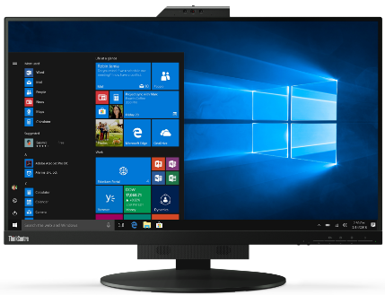




LENOVO TOPSELLER
ThinkCentre Tiny-in-One Monitors
While supplies last!
[ 7 OF 7 ]
ThinkCentre Tiny-in-One 27
TINY-IN-ONE 4
Price is Monitor Only.
ThinkCentre Tiny (Pictured) Sold Separately
ThinkCentre Tiny-in-One 22
Tiny-in-One 22 Monitor | $396.44
 | 11GSPAR1US
 | 21.5” WLED Borderless Panel
 | 1080p Non-Touch Display
 | 720p Webcam w/ Dual Mic and ThinkShutter Cover
 | 1 x USB Type A port (Side)
 | Tiny PC Compatibility (AIO Mode)
 | DisplayPort In (Monitor Mode)
 | Lift / Tilt / Pivot Stand Adjustment
 | 3 Year Adv. Exchange Warranty
Tiny-in-One 24 Monitor | $428.24
 | 11GDPAR1US
 | 23.8” WLED Borderless Panel
 | 1080p Non-Touch Display
 | 1080p Webcam w/ Dual Mic
 | 1 x USB Type A port (Side)
 | Tiny PC Compatibility (AIO Mode)
 | DisplayPort In (Monitor Mode)
 | Lift / Tilt / Pivot Stand Adjustment
 | 3 Year Adv. Exchange Warranty
Tiny-in-One 27 Monitor | $608.44
 | 11JHRAR1US
 | 27” WLED Borderless Panel
 | 1440p Non-Touch Display
 | 1080p RGB/IR Webcam w/ Dual Mic
 | 2 x USB 3.1 port (Side)
 | Tiny PC Compatibility (AIO Mode)
 | DisplayPort / HMDI In (Monitor Mode)
 | Lift / Tilt / Pivot Stand Adjustment
 | 3 Year Adv. Exchange Warranty
Tiny-in-One 24 Touch Monitor | $523.64
 | 11GCPAR1US
 | 23.8” WLED Borderless Panel
 | 1080p Touch Display
 | 720p Webcam w/ Dual Mic
 | 1 x USB A port (Side)
 | Tiny PC Compatibility (AIO Mode)
 | DisplayPort In (Monitor Mode)
 | Lift / Tilt / Pivot Stand Adjustment
 | 3 Year Adv. Exchange Warranty

Slide 22
Mobile Workstations & ThinkStation

Slide 23
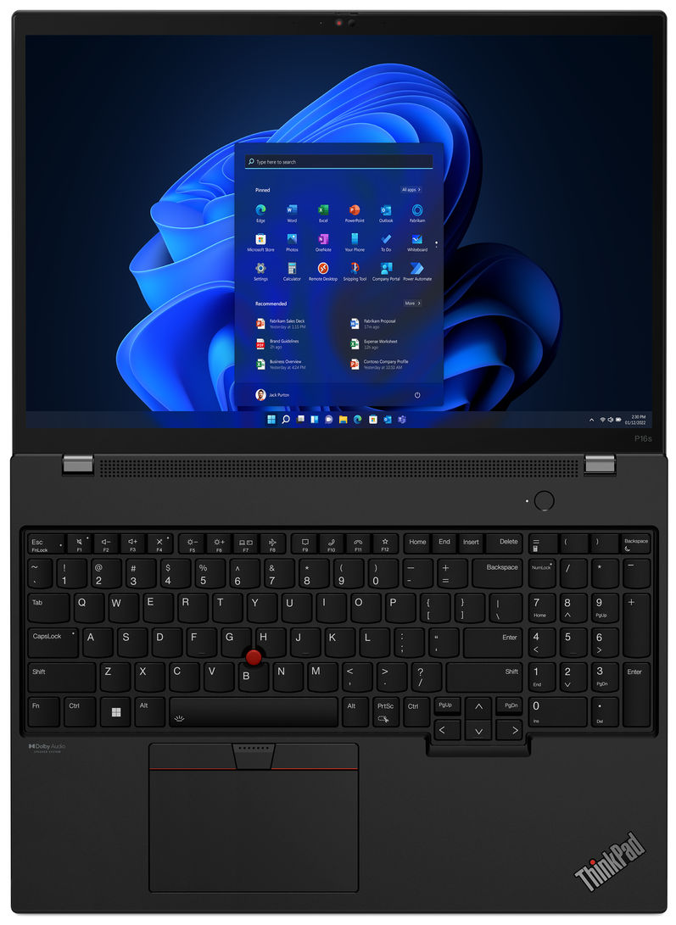
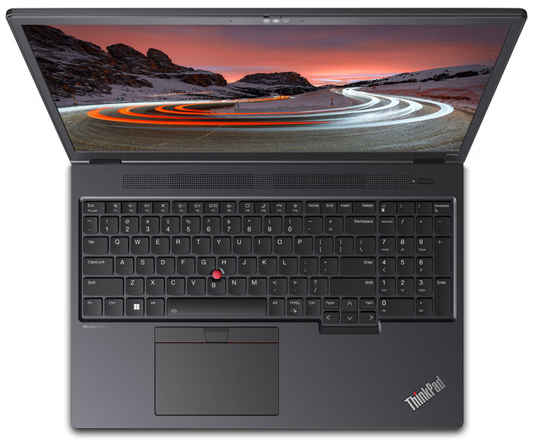
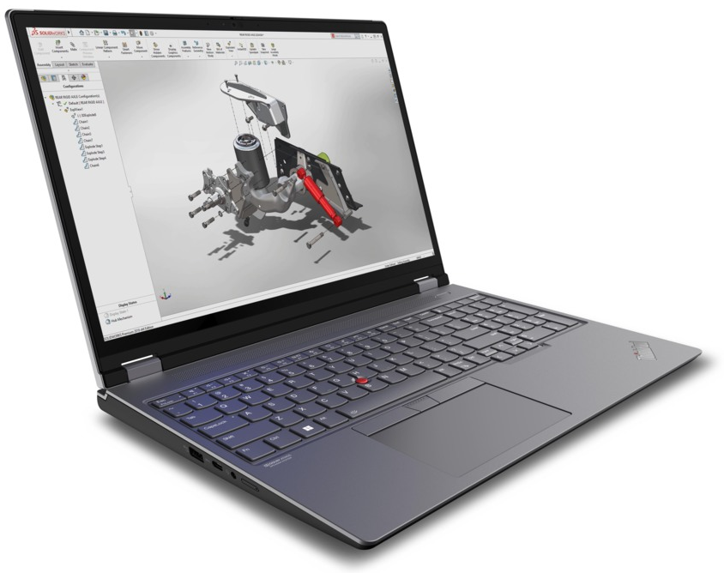




Lenovo Topseller ThinkPad Mobile Workstations
ThinkPad P14s Intel
ThinkPad P14s AMD
Ultra-portable 14-inch
with all-day battery
ThinkPad P16s Intel
ThinkPad P16s AMD
Thin & light 16-inch with all-day battery
ThinkPad P16v Intel
ThinkPad P15v/T15p Intel
ThinkPad P15v/P16v AMD
Value 15.6/16-inch
NVIDIA professional (P16v/P15v) or consumer GeForce graphics (T15p)
ThinkPad P1
Ultra-premium 16-inch*
Now even more performance up to NVIDIA RTX 5000 Ada graphics
ThinkPad P16
Ultra-Performance 16-inch
Intel HX CPUs with
up to NVIDIA RTX 5000 Ada graphics

Slide 24
Lenovo Topseller ThinkPad Mobile Workstations
P14s & P16s Intel | Ultraportable performance
P14s Gen 4 14” Ultra-portable | $2,279 | $2,449 | $2,789 | $2,849 | $3,089 | $3,299
 |  | $250 Rebate |  |  | $100 Rebate
 | 21HF000CUS | 21HF000AUS | 21HF001KUS | 21HF001TUS | 21HF001MUS | 21HF001NUS
 | Core i5-1340P | Core i7-1360P | Core i7-1360P | Core i7-1370P vPro | Core i7-1360P | Core i7-1370P vPro
 | 16GB DDR5 5200 | 16GB DDR5 5200 | 16GB LPDDR5 4800 | 16GB LPDDR5 4800 | 32GB LPDDR5 4800 | 32GB LPDDR5 4800
 | 512GB PCIe SSD | 512GB PCIe SSD | 512GB PCIe SSD | 512GB PCIe SSD | 1TB PCIe SSD | 1TB PCIe SSD
 | 14” 16:10 WUXGA (FHD+) IPS 5MP-IR Camera | 14” 16:10 WUXGA (FHD+) IPS 5MP-IR Camera | 14” 16:10 WUXGA (FHD+) IPS touch 5MP-IR Camera | 14” 16:10 WUXGA (FHD+) IPS 5MP-IR Camera | 14” 16:10 WUXGA (FHD+) IPS 5MP-IR Camera | 14” 16:10 WUXGA (FHD+) IPS touch 5MP-IR Camera
 | Intel UHD Graphics | Intel UHD Graphics | NVIDIA RTX A500 4GB | NVIDIA RTX A500 4GB | NVIDIA RTX A500 4GB | NVIDIA RTX A500 4GB
 | Win 11 Pro 64 | Win 11 Pro 64 | Win 11 Pro 64 | Win 11 Pro 64 | Win 11 Pro 64 | Win 11 Pro 64
 | 3yr Premier Support | 3yr Premier Support | 3yr Premier Support | 3yr Premier Support | 3yr Premier Support | 3yr Premier Support
 | 3yr Battery Warranty | 3yr Battery Warranty | 3yr Battery Warranty | 3yr Battery Warranty | 3yr Battery Warranty | 3yr Battery Warranty
P14s Gen 4 and P16s Gen 2
Refreshed design with same great look of the previous generation and numerous upgrades internally. Featuring Intel Raptor Lake CPUs and NVIDIA RTX professional graphics.
Featuring:
13th Gen Intel Core P28 CPUs
Optional OLED displays
NVIDIA RTX A500 GPU
Optional Intel Iris Xe Integrated Graphics*
Gen4 PCIe M.2 storage
Up to 64GB of DDR5 RAM**
New 5 Megapixel FHD webcam
* Dual channel memory required
(populate empty DIMM for Iris Xe)
** Requires i7 vPro+A500; dual soldered DIMMs
P16s Gen 2 16” Ultra-portable | $2,499 | $2,659 | $2,759 | $2,829 | $3,129 | $3,289
 |  | $200 Rebate | $100 Rebate | $250 Rebate
 | 21HK0007US | 21HK0008US | 21HK003EUS | 21HK003JUS | 21HK003PUS | 21HK003QUS
 | Core i7-1360P | Core i7-1370P vPro | Core i7-1360P | Core i7-1360P | Core i7-1360P | Core i7-1370P vPro
 | 16GB DDR5 5200 | 16GB DDR5 5200 | 16GB LPDDR5 4800 | 16GB LPDDR5 4800 | 32GB LPDDR5 4800 | 32GB LPDDR5 4800
 | 512GB PCIe SSD | 512GB PCIe SSD | 512GB PCIe SSD | 512GB PCIe SSD | 1TB PCIe SSD | 1TB PCIe SSD
 | 14” 16:10 WUXGA (FHD+) IPS 5MP-IR Camera | 14” 16:10 WUXGA (FHD+) IPS 5MP-IR Camera | 14” 16:10 WUXGA (FHD+) IPS 5MP-IR Camera | 16” 16:10 WUXGA (FHD+) IPS touch 5MP-IR Camera | 14” 16:10 WUXGA (FHD+) IPS 5MP-IR Camera | 14” 16:10 WUXGA (FHD+) IPS 5MP-IR Camera
 | Intel UHD Graphics | Intel UHD Graphics | NVIDIA RTX A500 4GB | NVIDIA RTX A500 4GB | NVIDIA RTX A500 4GB | NVIDIA RTX A500 4GB
 | Win 11 Pro 64 | Win 11 Pro 64 | Win 11 Pro 64 | Win 11 Pro 64 | Win 11 Pro 64 | Win 11 Pro 64
 | 3yr Premier Support | 3yr Premier Support | 3yr Premier Support | 3yr Premier Support | 3yr Premier Support | 3yr Premier Support
 | 3yr Battery Warranty | 3yr Battery Warranty | 3yr Battery Warranty | 3yr Battery Warranty | 3yr Battery Warranty | 3yr Battery Warranty

Slide 25
Lenovo Topseller ThinkPad Mobile Workstations
P14s & P16s AMD | Ultraportable performance
P14s AMD Gen 4 14” Ultra-portable | $1,899 | $1,649 | $2,099
 | $100 Rebate |  | $100 Rebate
 | 21K50012US | 21K5000YUS | 21K5001BUS
 | Ryzen 7 Pro 7840U | Ryzen 7 Pro 7840U | Ryzen 7 Pro 7840U
 | 16GB LPDDR5 6400 | 32GB LPDDR5 6400 | 32GB LPDDR5 6400
 | 512GB PCIe SSD | 512GB PCIe SSD | 1TB PCIe SSD
 | 14” 16:10 WUXGA (FHD+) IPS 5MP-IR Camera | 14” 16:10 WUXGA (FHD+) IPS touch 5MP-IR Camera | 14” 16:10 WUXGA (FHD+) IPS 5MP-IR Camera
 | AMD RDNA3 Graphics | AMD RDNA3 Graphics | AMD RDNA3 Graphics
 | Win 11 Pro 64 | Win 11 Pro 64 | Win 11 Pro 64
 | 3yr Premier Support | 3yr Premier Support | 3yr Premier Support
 | 3yr Battery Warranty | 3yr Battery Warranty | 3yr Battery Warranty
P14s AMD Gen 4 and P16s AMD Gen 2
Refreshed design with same low-weight formfactor and all day battery life. Featuring AMD Ryzen 7040U CPUs and AMD RDNA3 integrated graphics.
Featuring:
AMD Ryzen PRO 7040U CPUs
RDNA3 integrated graphics
Optional OLED displays
Gen4 PCIe M.2 storage
Up to 64GB of DDR5 RAM**
New 5 Megapixel FHD webcam
All-day battery life
** Requires R7 Pro; dual soldered DIMMs
P16s AMD Gen 2 16” Ultra-portable | $1,969 | $2,149 | $2,169
 | 21K90016US | 21K9001CUS | 21K90017US
 | Ryzen 7 Pro 7840U | Ryzen 7 Pro 7840U | Ryzen 7 Pro 7840U
 | 16GB LPDDR5 6400 | 32GB LPDDR5 6400 | 32GB LPDDR5 6400
 | 512GB PCIe SSD | 512GB PCIe SSD | 1TB PCIe SSD
 | 16” 16:10 WUXGA (FHD+) IPS 5MP-IR Camera | 16” 16:10 WUXGA (FHD+) IPS touch 5MP-IR Camera | 16” 16:10 WUXGA (FHD+) IPS 5MP-IR Camera
 | AMD RDNA3 Graphics | AMD RDNA3 Graphics | AMD RDNA3 Graphics
 | Win 11 Pro 64 | Win 11 Pro 64 | Win 11 Pro 64
 | 3yr Premier Support | 3yr Premier Support | 3yr Premier Support
 | 3yr Battery Warranty | 3yr Battery Warranty | 3yr Battery Warranty

Slide 26

Lenovo Topseller ThinkPad Mobile Workstations
P16v Intel and AMD Value of Performance
P16v Gen 1 Intel Performance Value | $2,939 | $3,249 | $3,749 | $4,119
 | $250 Rebate |  | $200 Rebate
 | 21FC0036US | 21FC0038US | 21FC003FUS | 21FC003KUS
 | Core i7-13700H | Core i7-13700H | Core i7-13800H vPro | Core i9-13900H vPro
 | 16GB DDR5 5200 | 16GB DDR5 5200 | 32GB DDR5 4800 | 32GB DDR5 4800
 | 512GB PCIe SSD | 512GB PCIe SSD | 1TB PCIe SSD | 1TB PCIe SSD
 | 16” 16:10 WUXGA (FHD+) IPS 5MP-IR Camera | 16” 16:10 WUXGA (FHD+) IPS 5MP-IR Camera | 16” 16:10 WUXGA (FHD+) IPS 5MP-IR Camera | 16” 16:10 WUXGA (FHD+) IPS 5MP-IR Camera
 | NVIDIA RTX A500 4GB | NVIDIA RTX A1000 6GB | NVIDIA RTX A1000 6GB | NVIDIA RTX 2000 Ada 8GB
 | Win 11 Pro 64 | Win 11 Pro 64 | Win 11 Pro 64 | Win 11 Pro 64
 | 3yr Premier Support | 3yr Premier Support | 3yr Premier Support | 3yr Premier Support
 | 3yr Battery Warranty | 3yr Battery Warranty | 3yr Battery Warranty | 3yr Battery Warranty
P16v Gen 1
Get the most performance for your dollar with this clean sheet redesign featuring larger displays and a new improved thermal design. Enjoy the latest Intel Raptor Lake or AMD Ryzen H CPUs and NVIDIA professional graphics.
Featuring:
13th Gen Intel H-class CPUs (45W)
  AMD Ryzen-H Pro (45W)
Larger 16” 16:10 Displays
Up to NVIDIA RTX 2000 Ada (8GB)
Up to 64GB DDR5 RAM (96GB TBD)
New 5 Megapixel FHD webcam
P16v Gen 1 AMD Performance Value | $2,649 | $2,849
 |  | $200 Rebate
 | 21FE0027US | 21FE0028US
 | Ryzen 7 Pro 7840HS | Ryzen 7 Pro 7840HS
 | 16GB DDR5 5200 | 32GB DDR5 5200
 | 512GB PCIe SSD | 1TB PCIe SSD
 | 16” 16:10 WUXGA (FHD+) IPS 5MP-IR Camera | 16” 16:10 WUXGA (FHD+) IPS 5MP-IR Camera
 | NVIDIA RTX A1000 6GB | NVIDIA RTX A1000 6GB
 | Win 11 Pro 64 | Win 11 Pro 64
 | 3yr Premier Support | 3yr Premier Support
 | 3yr Battery Warranty | 3yr Battery Warranty

Slide 27



Lenovo Topseller ThinkPad Mobile Workstations
P16 | The Most Powerful ThinkPad Ever
[ 3 OF 8 ]
P16 Gen 2
Refreshed design with the same amazing thermal solution. Further the desktop replacement capabilities from last generation with the latest in NVIDIA professional graphics and Intel Raptor Lake CPUs offering up to 24 total cores in the Core i9.
Featuring:
13th Gen Intel HX-class CPUs (55W)
Up to NVIDIA RTX 5000 Ada
Up to 128GB DDR5 RAM (196GB TBD)
Up to 8TB Gen4 PCIe Storage
  Contact Lenovo Rep
New QHD+ Display with 165Hz refresh rate
P16 Gen 2 Ultimate Performance | $3,479 | $4,149 | $4,529 | $5,299
 | $300 Rebate | $675 Rebate
 | 21FA0032US | 21FA002TUS | 21FA002NUS | 21FA002XUS
 | Core i7-13700HX 16C | Core i7-13700HX 16C | Core i9-13950HX 24C vPro | Core i7-13700HX 16C
 | 16GB DDR5 4000 | 32GB DDR5 4000 | 32GB DDR5 4000 | 32GB DDR5 4000
 | 512GB PCIe SSD | 1TB PCIe SSD | 1TB PCIe SSD | 1TB PCIe SSD
 | 16” 16:10 WQXGA (QHD+) IR Cam | 16” 16:10 WQXGA (QHD+) IR Cam | 16” 16:10 WQXGA (QHD+) IR Cam | 16” 16:10 WQXGA (QHD+) IR Cam
 | NVIDIA RTX A1000 6GB | NVIDIA RTX 2000 Ada 8GB | NVIDIA RTX 2000 Ada 8GB | NVIDIA RTX 4000 Ada 12GB
 | Win 11 Pro 64 | Win 11 Pro 64 | Win 11 Pro 64 | Win 11 Pro 64
 | 3yr Premier Support | 3yr Premier Support | 3yr Premier Support | 3yr Premier Support
 | 3yr Battery Warranty | 3yr Battery Warranty | 3yr Battery Warranty | 3yr Battery Warranty

Slide 28


Lenovo Topseller ThinkPad Mobile Workstations
P1 | The Machine You Need in the Device You Want
P1 Gen 6
Refreshed design on the most powerful thin and light workstation. The best gets better with the latest Intel Raptor Lake CPUs and NVIDIA professional graphics. Offering brand new 4K OLED touch display and more GeForce graphics options.
Featuring:
13th Gen Intel H-class CPUs (45W)
Up to NVIDIA RTX 5000 Ada
  Also offering GeForce RTX 4060/4080/4090
Up to 64GB DDR5 RAM (96GB TBD)
New 4K OLED touch display
  New 5 Megapixel FHD webcam
P1 Gen 6 Ultra-premium performance | $3,739 | $4,489 | $4,899 | $6,149
 | $250 Rebate | $250 Rebate |  | $650 Rebate
 | 21FV001DUS | 21FV001PUS | 21FV001GUS | 21FV001UUS
 | Core i7-13700H | Core i7-13700H | Core i7-13700H | Core i9-13900H vPro
 | 16GB DDR5 5600 | 32GB DDR5 5600 | 32GB DDR5 5600 | 32GB DDR5 5600
 | 512GB PCIe SSD | 1TB PCIe SSD | 1TB PCIe SSD | 1TB PCIe SSD
 | 16” 16:10 WQXGA (QHD+) IR Cam | 16” 16:10 WQXGA (QHD+) IR Cam | 16” 16:10 WQUXGA (UHD+) OLED touch 5MP IR Cam | 16” 16:10 WQXGA (QHD+) IR Cam
 | NVIDIA RTX A1000 6GB | NVIDIA RTX 2000 Ada 8GB | NVIDIA RTX 2000 Ada 8GB | NVIDIA GeForce RTX 4090 16GB
 | Win 11 Pro 64 | Win 11 Pro 64 | Win 11 Pro 64 | Win 11 Pro 64
 | 3yr Premier Support | 3yr Premier Support | 3yr Premier Support | 3yr Premier Support
 | 3yr Battery Warranty | 3yr Battery Warranty | 3yr Battery Warranty | 3yr Battery Warranty

Slide 29
Lenovo Topseller ThinkPad Mobile Workstations
While Supply Lasts!
The following pages contain product families that are nearing the end of lifecycle and will only be available while current supply/inventory lasts.
If your current configuration is sold out, you should transition your customers according to the chart on the right.
Family
P14s Gen 3
P16s Gen 1
P14s AMD Gen 3
P16s AMD Gen 1
P15v Gen 3
T15p Gen 3
P15v AMD
P1 Gen 5
P16 Gen 1
Family
P14s Gen 4
P16s Gen 2
coming soon!
coming soon!
P16v Gen 1
No Transition
P16v AMD
P1 Gen 6
P16 Gen 2

Slide 30
Lenovo Topseller ThinkPad Mobile Workstations
P14s & P16s | Ultraportable performance
P14s Gen 3 14” Ultra-portable | $2,119 | $2,909 | $3,129 | $3,359 | $3,579 | $3,859
 |  |  | $300 Rebate | $350 Rebate
 | 21AK002FUS | 21AK002CUS | 21AK002HUS | 21AK0028US | 21AK002GUS | 21AK0029US
 | Core i7-1270P | Core i7-1260P | Core i7-1280P | Core i7-1260P | Core i7-1280P | Core i7-1280P
 | 16GB DDR4 3200 | 16GB DDR4 3200 | 16GB DDR4 3200 | 32GB DDR4 3200 | 32GB DDR4 3200 | 32GB DDR4 3200
 | 512GB PCIe SSD | 512GB PCIe SSD | 512GB PCIe SSD | 1TB PCIe SSD | 1TB PCIe SSD | 1TB PCIe SSD
 | 14” 16:10 FHD+ IPS IR Camera | 14” 16:10 FHD+ IPS Touch IR Camera | 14” 16:10 FHD+ IPS IR Camera | 14” 16:10 FHD+ IPS IR Camera | 14” 16:10 FHD+ IPS IR Camera | 14” UHD+ Touch IR Camera
 | Intel Iris Xe Graphics | NVIDIA Quadro T550 4GB | NVIDIA Quadro T550 4GB | NVIDIA Quadro T550 4GB | NVIDIA Quadro T550 4GB | NVIDIA Quadro T550 4GB
 | Win 11 Pro 64 | Win 11 Pro 64 | Win 11 Pro 64 | Win 11 Pro 64 | Win 11 Pro 64 | Win 11 Pro 64
 | Premier Support | Premier Support | Premier Support | Premier Support | Premier Support | Premier Support
 | 3 Year Warranty | 3 Year Warranty | 3 Year Warranty | 3 Year Warranty | 3 Year Warranty | 3 Year Warranty
**While Supply Lasts!!!
Transition to P14s Gen 4
Transition to P16s Gen 2
P14s Gen 3 and P16s Gen 1
Featuring:
12th Gen Intel Core P28 CPUs
16:10 displays; narrow bezels
NVIDIA T550 GPU
Offering Intel Iris Xe Integrated Graphics
Gen4 PCIe M.2 storage
Up to 48GB of DDR4 RAM
P16s Gen 1 16” Ultra-portable | $2,089 | $2,099 | $2,139 | $2,159 | $2,319 | $2,439 | $2,649
 | Core i5-1250P | Core i7-1260P | Core i7-1270P | Core i7-1260P | Core i7-1280P | Core i7-1260P | Core i7-1280P
 | 16GB DDR4 3200 | 16GB DDR4 3200 | 16GB DDR4 3200 | 16GB DDR4 3200 | 16GB DDR4 3200 | 32GB DDR4 3200 | 32GB DDR4 3200
 | 512GB PCIe SSD | 512GB PCIe SSD | 512GB PCIe SSD | 512GB PCIe SSD | 512GB PCIe SSD | 1TB PCIe SSD | 1TB PCIe SSD
 | 16” 16:10 FHD+ IPS IR Camera | 16” 16:10 FHD+ IPS IR Camera | 16” 16:10 FHD+ IPS IR Camera | 16” 16:10 FHD+ IPS Touch IR Camera | 16” 16:10 FHD+ IPS IR Camera | 16” 16:10 FHD+ IPS IR Camera | 16” 16:10 FHD+ IPS IR Camera
 | NVIDIA Quadro T550 4GB | NVIDIA Quadro T550 4GB | Intel Iris Xe Graphics | NVIDIA Quadro T550 4GB | NVIDIA Quadro T550 4GB | NVIDIA Quadro T550 4GB | NVIDIA Quadro T550 4GB
 | Win 11 Pro 64 | Win 11 Pro 64 | Win 11 Pro 64 | Win 11 Pro 64 | Win 11 Pro 64 | Win 11 Pro 64 | Win 11 Pro 64
 | Premier Support | Premier Support | Premier Support | Premier Support | Premier Support | Premier Support | Premier Support
 | 3 Year Warranty | 3 Year Warranty | 3 Year Warranty | 3 Year Warranty | 3 Year Warranty | 3 Year Warranty | 3 Year Warranty

Slide 31



Lenovo Topseller ThinkPad Mobile Workstations
P14s & P16s AMD | Ultraportable performance value
**While Supply Lasts!!!
P14s AMD Gen 3 14” Ultra-portable | $2,509 | $2,789 | $2,179
 |  | $300 Rebate
 | 21J5000VUS | 21J5000XUS | 21J50010US
 | R7 Pro 6850U | R7 Pro 6850U | R7 Pro 6850U
 | 16GB LPDDR5 6400MHz | 32GB LPDDR5 6400MHz | 32GB LPDDR5 6400MHz
 | 512GB Gen4 PCIe SSD | 512GB Gen4 PCIe SSD | 1TB Gen4 PCIe SSD
 | 14” 16:10 WUXGA (FHD+) IR Cam | 14” 16:10 WUXGA (FHD+) touch IR Cam | 14” 16:10 WUXGA (FHD+) IR Cam
 | RDNA2 Integrated Graphics | RDNA2 Integrated Graphics | RDNA2 Integrated Graphics
 | Premier Support | Premier Support | Premier Support
 | 3 Year Warranty | 3 Year Warranty | 3 Year Warranty
P16s AMD Gen 1 16” Ultra-portable | $2,619 | $2,049 | $2,259
 | $250 Rebate
 | 21CK001MUS | 21CK005FUS | 21CK005JUS
 | R7 Pro 6850U | R7 Pro 6850U | R7 Pro 6850U
 | 16GB LPDDR5 6400MHz | 32GB LPDDR5 6400MHz | 32GB LPDDR5 6400MHz
 | 512GB Gen4 PCIe SSD | 512GB Gen4 PCIe SSD | 1TB Gen4 PCIe SSD
 | 16” 16:10 WUXGA (FHD+) IR Cam | 16” 16:10 WUXGA (FHD+) IR Cam | 16” 16:10 WUXGA (FHD+) touch IR Cam
 | RDNA2 Integrated Graphics | RDNA2 Integrated Graphics | RDNA2 Integrated Graphics
 | Premier Support | Premier Support | Premier Support
 | 3 Year Warranty | 3 Year Warranty | 3 Year Warranty
P14s AMD Gen 3
P16s AMD Gen 1
New clean sheet design. Powerful and mobile. The P14s AMD Gen 2 will transition to the P14s AMD Gen 3.
Featuring:
AMD 6nm Rembrandt Ryzen CPUs
RDNA2 Radeon Integrated Graphics
16:10 aspect ratio displays
Up to 32GB of LPDDR5 (Soldered)
  6400Mhz
  Low latency
  Blazing fast
Gen4 PCIe M.2 storage – Up to 2TB
2.82lb / 3.7lb

Slide 32
Lenovo Topseller ThinkPad Mobile Workstations
P15v & T15p | Value of Performance
P15v Gen 3 Performance Value | $2,609 | $2,879 | $2,979 | $2,699 | $3,809
 |  |  | $300 Rebate |  | $100 Rebate
 | 21D8003BUS | 21D80033US | 21D8003HUS | 21D8003JUS | 21D8004CUS
 | Core i5-12500H 12C | Core i7-12700H 14C | Core i7-12700H 14C | Core i7-12700H 14C | Core i7-12800H 14C
 | 16GB DDR5 4800 | 16GB DDR5 4800 | 16GB DDR5 4800 | 32GB DDR5 4800 | 32GB DDR5 4800
 | 512GB PCIe SSD | 512GB PCIe SSD | 512GB PCIe SSD | 1TB PCIe SSD | 1TB PCIe SSD
 | 15.6” FHD IR Cam | 15.6” FHD IR Cam | 15.6” FHD IR Cam | 15.6” UHD IR Cam | 15.6” FHD IR Cam
 | Intel Iris Xe | NVIDIA T600 4GB | NVIDIA T1200 4GB | NVIDIA T1200 4GB | NVIDIA A2000 4GB
 | Premier Support | Premier Support | Premier Support | Premier Support | Premier Support
 | 3 Year Warranty | 3 Year Warranty | 3 Year Warranty | 3 Year Warranty | 3 Year Warranty
**While Supply Lasts!!!
Transition to P16v Gen 1
P15v Gen 3 and T15p Gen 3
Featuring:
12th Gen Intel H-class CPUs (45W)
Up to NVIDIA RTX A2000
Up to 64GB DDR5 RAM
NVIDIA RTX 3050 4GB (T15p)
T15p Gen 3 Entry Power User/Prosumer | $2,639 | $2,059 | $2,939 | $2,439 | $3,579
 |  |  | $100 Rebate
 | 21DA000YUS | 21DA0011US | 21DA0010US | 21DA000WUS | 21DA000XUS
 | Core i7-12700H 14C | Core i7-12700H 14C | Core i7-12700H 14C | Core i7-12700H 14C | Core i7-12700H 14C
 | 8GB DDR5 4800 | 8GB DDR5 4800 | 16GB DDR5 4800 | 32GB DDR5 4800 | 32GB DDR5 4800
 | 256GB PCIe SSD | 512GB PCIe SSD | 512GB PCIe SSD | 1TB PCIe SSD | 1TB PCIe SSD
 | 15.6" FHD 2D Camera | 15.6" FHD IR Camera | 15.6" FHD IR Camera | 15.6" FHD IR Camera | 15.6" UHD IR Camera
 | NVIDIA GeForce RTX 3050 | NVIDIA GeForce RTX 3050 | NVIDIA GeForce RTX 3050 | NVIDIA GeForce RTX 3050 | NVIDIA GeForce RTX 3050
 | Premier Support | Premier Support | Premier Support | Premier Support | Premier Support
 | 3 Year Warranty | 3 Year Warranty | 3 Year Warranty | 3 Year Warranty | 3 Year Warranty

Slide 33



Lenovo Topseller ThinkPad Mobile Workstations
P15v AMD | Value of Performance
**While Supply Lasts!!!
P15v AMD 15” Mainstream Performance | $2,099 | $2,379 | $3,449
 |  |  | $100 Rebate
 | 21EM004GUS | 21EM004FUS | 21EM001NUS
 | R7 Pro 6850H | R7 Pro 6850H | R7 Pro 6850H
 | 16GB DDR5 4800MHz | 32GB DDR5 4800MHz | 32GB DDR5 4800MHz
 | 512GB Gen4 PCIe SSD | 1TB Gen4 PCIe SSD | 1TB Gen4 PCIe SSD
 | 15.6 FHD IPS IR Cam | 15.6 FHD IPS IR Cam | 15.6 FHD IPS IR Cam
 | NVIDIA T1200 4GB | NVIDIA T1200 4GB | NVIDIA RTX A2000 4GB
 | Premier Support | Premier Support | Premier Support
 | 3 Year Warranty | 3 Year Warranty | 3 Year Warranty
P15v AMD
New clean sheet design. Offering powerful performance at a competitive value. Now featuring 45W AMD-H CPUs with NVIDIA professional GPUs.
Featuring:
AMD 6nm Rembrandt Ryzen-H CPUs (45W)
Up to NVIDIA A2000 (4GB) GPU
Up to 64GB of DDR5 (4800MHz)
Gen4 PCIe M.2 storage – Up to 4TB
4.91lbs

Slide 34
Lenovo Topseller ThinkPad Mobile Workstations
P1 | The Machine You Need in the Device You Want
**While Supply Lasts!!!
Transition to P1 Gen 6
P1 Gen 5
Featuring:
12th Gen Intel H-class CPUs (45W)
Up to NVIDIA RTX A5500
  Also offering GeForce RTX 3070Ti/3080Ti
Up to 64GB DDR5 RAM
All displays with X-Rite Factory Color Calibration and Low Blue Light Eyesafe® certification
QHD+ with high refresh rate (165Hz)
Liquid metal cooling
Starting at 3.99lb (1.81kg)
P1 Gen 5 Ultra-premium performance | $2,659 | $3,939 | $3,139
 |  | $500 Rebate | $100 Rebate
 | 21DC006MUS | 21DC006KUS | 21DC004AUS
 | Core i7-12700H 14C | Core i7-12800H 14C vPro | Core i7-12700H 14C
 | 16GB DDR5 4800 | 16GB DDR5 4800 | 32GB DDR5 4800
 | 512GB Gen4 PCIe SSD | 512GB Gen4 PCIe SSD | 1TB Gen4 PCIe SSD
 | 16” 16:10 WQXGA (QHD+) IR Cam | 16” 16:10 WQXGA (QHD+) IR Cam | 16” 16:10 WQXGA (QHD+) IR Cam, Touch
 | NVIDIA RTX A1000 (4GB) | NVIDIA RTX A1000 (4GB) | NVIDIA RTX A1000 (4GB)
 | Premier Support | Premier Support | Premier Support
 | 3 Year Warranty | 3 Year Warranty | 3 Year Warranty

Slide 35




Lenovo Topseller ThinkPad Mobile Workstations
P16 | The Most Powerful ThinkPad Ever
[ 3 OF 8 ]
**While Supply Lasts!!!
Transition to P16 Gen 2
P16 Gen 1 Ultimate Performance | $3,589 | $2,979 | $3,259 | $3,569 | $3,769
 | $550 Rebate
 | 21D6005MUS | 21D6007XUS | 21D60083US | 21D60082US | 21D60081US
 | Core i7-12800HX 16C | Core i9-12900HX 16C | Core i9-12900HX 16C | Core i9-12900HX 16C | Core i9-12900HX 16C
 | 16GB DDR5 4000MHz | 16GB DDR5 4000MHz | 32GB DDR5 4000MHz | 32GB DDR5 4000MHz | 32GB DDR5 4000MHz
 | 512GB Gen4 PCIe SSD | 512GB Gen4 PCIe SSD | 1TB Gen4 PCIe SSD | 1TB Gen4 PCIe SSD | 1TB Gen4 PCIe SSD
 | 16” 16:10 WQXGA (QHD+) IR Cam | 16” 16:10 WQUXGA (UHD+) IR Cam | 16” 16:10 WQUXGA (UHD+) IR Cam | 16” 16:10 WQUXGA (UHD+) IR Cam | 16” 16:10 WQUXGA (UHD+) IR Cam
 | NVIDIA RTX A1000 (4GB) | Intel UHD Integrated Graphics | Intel UHD Integrated Graphics | NVIDIA RTX A1000 (4GB) | NVIDIA RTX A2000 (8GB)
 | Premier Support | Premier Support | Premier Support | Premier Support | Premier Support
 | 3 Year Warranty | 3 Year Warranty | 3 Year Warranty | 3 Year Warranty | 3 Year Warranty
P16 Gen 1
Completely new design. P15 and P17 will transition to the ThinkPad P16 Gen 1
Featuring:
12th Gen Intel HX-class CPUs (55W)
Up to NVIDIA RTX A5500
Up to 128GB DDR5 RAM
Up to 8TB Gen4 PCIe Storage
  Contact Lenovo Rep
UHD+ OLED touch coming soon
  16” 16:10 Display
Brand new thermal design

Slide 36

Lenovo Topseller ThinkStation Desktop Workstations
PX
WORLD’S MOST ADVANCED DUAL SOCKET PERFORMANCE WORKSTATION
P5
EXPERT SINGLE SOCKET WORKSTATION
P7
ADVANCED AND VERSATILE SUPER SOCKET TOWER
P620
LIMITLESS
POSSIBILITIES
P3 Ultra
REDEFIGNING THE POWER OF SMALL
P3 Tower
POWER OF A WORKSTATION,
PRICE OF A
DESKTOP
P3 Tiny
WORLD’S SMALLEST WORKSTATION
P358 (AMD) Tower
SUB-ENTRY WORKSTATION

Slide 37


Lenovo Topseller ThinkStation Desktop Workstations
P3 Tiny | World’s Smallest Professional Desktop Workstation
Now available with Intel 13th Gen Core Performance
P3 Tiny | $2,269 | $1,909 | $3,099 | $3,369
 |  | $200 Rebate | $250 Rebate | $250 Rebate
 | 30H00013US | 30H0000XUS | 30H00010US | 30H00011US
 | Core i7-13700T 16C | Core i7-13700T 16C | Core i9-13900T 24C | Core i9-13900T 24C
 | 16GB non-ECC | 16GB non-ECC | 16GB non-ECC | 32GB non-ECC
 | 512GB PCIe Gen4 Performance SSD | 512GB PCIe Gen4 Performance SSD | 512GB PCIe Gen4 Performance SSD | 1TB PCIe Gen4 Performance SSD
 | NVIDIA T400 4GB | NVIDIA T1000 8GB | NVIDIA T1000 8GB | NVIDIA T400 4GB
 | Windows 11 Pro | Windows 11 Pro | Windows 11 Pro | Windows 11 Pro
 | 3 Year Premier Support | 3 Year Premier Support | 3 Year Premier Support | 3 Year Premier Support
Latest Intel pro processing power
Memory speeds up to 4800 GHz
Full power 65W CPUs now available with NVIDIA professional graphics
Ideal for engineering education & entry CAD/CAM users
Prices shown do not include rebate (if available).

Slide 38


Lenovo Topseller ThinkStation Desktop Workstations
P3 Ultra | Advanced Small Form Factor Workstation
Now available with Intel 13th Gen Core Performance
P3 Ultra | $2,539 | $2,659 | $3,329 | $3,739 | $4,099
 |  | $250 Rebate | $250 Rebate | $200 Rebate | $300 Rebate
 | 30HA0021US | 30HA001GUS | 30HA0024US | 30HA001YUS | 30HA001NUS
 | Core i7-13700 16C | Core i5-13600 14C | Core i9-13900 24C | Core i7-13700 16C | Core i9-13900 24C
 | 32GB non-ECC | 16GB non-ECC | 16GB non-ECC | 32GB non-ECC | 32GB non-ECC
 | 1TB PCIe Gen4 Performance SSD | 512GB PCIe Gen4 Performance SSD | 512GB PCIe Gen4 Performance SSD | 1TB PCIe Gen4 Performance SSD | 1TB PCIe Gen4 Performance SSD
 | NVIDIA T400 4GB | NVIDIA T1000 8GB | NVIDIA T1000 8GB | NVIDIA RTX A2000 12GB | NVIDIA RTX A2000 12GB
 | Windows 11 Pro | Windows 11 Pro | Windows 11 Pro | Windows 11 Pro | Windows 11 Pro
 | 3 Year Premier Support | 3 Year Premier Support | 3 Year Premier Support | 3 Year Premier Support | 3 Year Premier Support
Latest Intel pro processing power
Memory speeds up to 4000 GHz
Best-in-class ultrasmall performance up to NVIDIA RTX A5000M GPU
Ideal for intermediate engineering & creative professionals
Prices shown do not include rebate (if available).

Slide 39

Lenovo Topseller ThinkStation Desktop Workstations
P3 TWR | Entry Professional Desktop Workstation
Now available with Intel 13th Gen Core Performance
P3 Tower | $2,329 | $5,709
 |  | $650 Rebate
 | 30GS0031US | 30GS0036US
 | 750W Energy Star | 750W Energy Star
 | Core i7-13700 16C | Core i7-13700 16C
 | 16GB non-ECC | 32GB non-ECC
 | 512GB PCIe Gen4 Performance SSD | 1TB PCIe Gen4 Performance SSD
 | Intel Integrated Graphics | NVIDIA RTX A4500 20GB
 | Windows 11 Pro | Windows 11 Pro
 | 3 Year Premier Support | 3 Year Premier Support
All-new larger 27L chassis for increased scalability
Latest Intel pro processing power
Memory speeds up to 4800 GHz
Ideal config flexibility up to NVIDIA RTX A5000 GPU for more advanced engineering & creative professionals
Prices shown do not include rebate (if available).

Slide 40


Lenovo Topseller ThinkStation Desktop Workstations
P360 Tiny | World’s Smallest Professional Desktop Workstation
P360 Tiny | $2,099 | $2,849 | $3,199
 | $250 Rebate | $300 Rebate
 | 30FA001EUS | 30FA001BUS | 30FA005SUS
 | Core i7-12700T 12C | Core i9-12900T 16C | Core i9-12900T 16C
 | 16GB non-ECC | 16GB non-ECC | 32GB non-ECC
 | 512GB PCIe SSD | 512GB PCIe SSD | 1TB PCIe SSD
 | NVIDIA T400 4GB | NVIDIA T1000 8GB | NVIDIA T1000 4GB
 | Windows 11 Pro | Windows 11 Pro | Win 11 Pro License Preloaded with Win 10 Pro
 | 3 Year Premier Support | 3 Year Premier Support | 3 Year Premier Support
While supplies last!
Prices shown do not include rebate (if available).

Slide 41

Lenovo Topseller ThinkStation Desktop Workstations
P360 Ultra | Advanced Small Form Factor Workstation
While supplies last!
P360 Ultra | $2,489 | $2,369 | $3,599 | $3,179 | $3,999
 | $100 Rebate | $250 Rebate | $350 Rebate |  | $150 Rebate
 | 30G1000LUS | 30G1001AUS | 30G1000KUS | 30G10014US | 30G1001DUS
 | Core i5-12600 6C | Core i7-12700 12C | Core i7-12700 12C | Core i9-12900 16C | Core i9-12900 16C
 | 16GB non-ECC | 16GB non-ECC | 32GB non-ECC | 16GB non-ECC | 32GB non-ECC
 | 512GB PCIe SSD | 512GB PCIe SSD | 1TB PCIe SSD | 512GB PCIe SSD | 1TB PCIe SSD
 | NVIDIA T1000 8GB | NVIDIA T400 4GB | NVIDIA RTX A2000 12GB | NVIDIA T1000 8GB | NVIDIA RTX A2000 12GB
 | Windows 11 Pro | Windows 11 Pro | Windows 11 Pro | Windows 11 Pro | Windows 11 Pro
 | 3 Year Premier Support | 3 Year Premier Support | 3 Year Premier Support | 3 Year Premier Support | 3 Year Premier Support
Prices shown do not include rebate (if available).

Slide 42

Lenovo Topseller ThinkStation Desktop Workstations
P360 TWR | Entry Professional Desktop Workstation
P360 Tower | $1,419 | $2,669 | $3,299 | $2,719 | $4,129 | $4,499
 | 30FM002TUS | 30FM002HUS | 30FM002VUS | 30FM002RUS | 30FM0015US | 30FM0019US
 | 750W Energy Star | 750W Energy Star | 750W Energy Star | 750W Energy Star | 750W Energy Star | 750W Energy Star
 | Core i5-12500 6C | Core i7-12700 12C | Core i7-12700 12C | Core i9-12900 16C | Core i7-12700 12C | Core i9-12900 16C
 | 16GB non-ECC | 16GB non-ECC | 16GB non-ECC | 16GB non-ECC | 32GB non-ECC | 32GB non-ECC
 | 512GB PCIe SSD | 512GB PCIe SSD | 1TB PCIe SSD | 1TB PCIe SSD | 1TB PCIe SSD | 1TB PCIe SSD
 | NVIDIA T400 4GB | NVIDIA T1000 8GB | NVIDIA RTX A2000 12GB | NVIDIA RTX A2000 12GB | NVIDIA RTX A4000 16GB | NVIDIA RTX A4000 16GB
 | Windows 11 Pro | Windows 11 Pro | Windows 11 Pro | Windows 11 Pro | Windows 11 Pro | Windows 11 Pro
 | 3 Year Premier Support | 3 Year Premier Support | 3 Year Premier Support | 3 Year Premier Support | 3 Year Premier Support | 3 Year Premier Support
While supplies last!
Prices shown do not include rebate (if available).

Slide 43

Lenovo Topseller ThinkStation Desktop Workstations
P358 | AMD Ryzen Pro Entry TWR Workstation
While supplies last!
P358 AMD TWR | $1,429 | $1,629 | $1,399 | $1,439 | $3,289
 | End of production, while disti supply lasts |  |  | $100 Rebate
 | 30GL005FUS | 30GL0028US | 30GL003CUS | 30GL0020US | 30GL002CUS
 | AMD Ryzen 3 Pro 4350 (3.8 GHz, 4C 8T) | AMD Ryzen 5 Pro 5645 (3.7 GHz, 6C 12T) | AMD Ryzen 5 Pro 5645 (3.7 GHz, 6C 12T) | AMD Ryzen 7 Pro 5845 (3.4 GHz, 8C 16T) | AMD Ryzen 9 Pro 5945 (3.0 GHz, 12C 24T)
 | 16GB non-ECC | 8GB non-ECC | 16GB non-ECC | 16GB non-ECC | 32GB non-ECC
 | 512GB PCIe SSD | 256GB PCIe SSD | 512GB PCIe SSD | 512GB PCIe SSD | 1TB PCIe SSD
 | NVIDIA T1000 8GB | NVIDIA T1000 8GB | NVIDIA T400 4GB | NVIDIA T400 4GB | NVIDIA T1000 8GB
 | Win 11 Pro License Preloaded with Win 10 Pro | Windows 11 Pro | Windows 11 Pro | Windows 11 Pro | Windows 11 Pro
 | 3 Year Premier Support | 3 Year Premier Support | 3 Year Premier Support | 3 Year Premier Support | 3 Year Premier Support
Prices shown do not include rebate (if available).

Slide 44

Lenovo Topseller ThinkStation Desktop Workstations
Limited disty supply! Last chance to buy while supplies last!
P348 Intel TWR | $1,169 | $1,309 | $1,389
 | 30EQ024AUS | 30EQ024EUS | 30EQ024CUS
 | Core i5-11500 6C 500W | Core i7-11700 8C 8C 500W | Core i7-11700 8C 500W
 | 8GB non-ECC | 16GB non-ECC | 16GB non-ECC
 | 256GB PCIe SSD | 512GB PCIe SSD | 512GB PCIe SSD
 | NVIDIA T400 4GB | Intel HD Graphics Open to add discrete GPU | NVIDIA T400 4GB
 | Windows 11 Pro | Windows 11 Pro | Windows 11 Pro
 | 3 Year Premier Support | 3 Year Premier Support | 3 Year Premier Support
Prices shown do not include rebate (if available).

Slide 45
No P358 twr slide?

Slide 46




Lenovo Topseller ThinkStation Desktop Workstations
P620 & P5 | High Performance Tower Workstations
New!
ThinkStation P620
Uniquely ThinkStation, best-of-breed pro performance for:
  Digital Artists
  Engineers
  Life Scientists
  Software Developers
PCIe Gen 4-optimized NVIDIA graphics and fastest-available PCIe Gen 4 storage
ThinkStation P5
Uniquely ThinkStation, best-of-breed EXPERT performance for:
  Digital Artists
  Engineers
  Life Scientists
  Software Developers
All-new Intel Sapphire Rapids architecture with hyper-fast memory and future-proofed PCIe Gen5 readiness
P620 Workstation | $4,439 | $7,169
 | $600 Rebate | $1000 Rebate
 | 30E000M9US | 30E000MRUS
 | AMD Ryzen3 Threadripper PRO 5945WX 12 cores | AMD Ryzen3 Threadripper PRO 5955WX 16 cores
 | 1000W PSU | 1000W PSU
 | 32GB ECC | 64GB ECC
 | 1TB PCle Gen4 SSD | 2TB PCle Gen4 SSD
 | NVIDIA T400 4GB | NVIDIA RTX A2000 12 GB
 | Windows 11 Pro | Windows 11 Pro
 | 3 Year Premier Support | 3 Year Premier Support
P5 Workstation | $4,759 | $5,779 | $11,389
 | 30GA0014US | 30GA000UUS | 30GA0013US
 | Intel Xeon W-2425 6 cores | Intel Xeon W-2435 8 cores | Intel Xeon W-2445 10 cores
 | 1000W PSU | 1000W PSU | 1000W PSU
 | 32GB DDR5 4800 ECC (2x16) | 32GB DDR5 4800 ECC (2x16) | 32GB DDR5 4800 ECC (2x16)
 | 512GB PCle Gen4 SSD | 1TB PCle Gen4 SSD | 512GB PCle Gen4 SSD
 | NVIDIA T1000 8GB | NVIDIA RTX A2000 12GB | NVIDIA RTX A5500 24GB
 | Windows 11 Pro | Windows 11 Pro | Windows 11 Pro
 | 3 Year Premier | 3 Year Premier | 3 Year Premier
Prices shown do not include rebate (if available).

Slide 47




Lenovo Topseller ThinkStation Desktop Workstations
Performance Towers While Supplies Last through 2023
Prices shown do not include rebate (if available).
P520c Workstation | $1,939 | $5,859
 | 30BX00FLUS | 30BX00FVUS
 | Xeon W-2223 4 Cores | Xeon W-2225 4 Cores
 | 625W PSU | 625W PSU
 | 16GB ECC | 32GB ECC
 | 512GB PCle SSD | 1TB PCle SSD
 | NVIDIA A2000 6GB | NVIDIA RTX A4500
 | Windows 11 Pro | Windows 11 Pro
 | 3 Year Premier Support | 3 Year Premier Support
P520 Workstation | $2,429 | $3,259 | $3,089
 | 30BE00NMUS | 30BE00NLUS | 30BE00NAUS
 | Xeon W-2225 4 Cores | Xeon W-2245 8 Cores | Xeon W-2235 6 Cores
 | 1000W PSU | 1000W PSU | 1000W PSU
 | 16GB ECC | 32GB ECC | 32GB ECC
 | 512GB PCle SSD | 1TB PCle SSD | 1TB PCle SSD
 | Choose Graphics | Choose Graphics | NVIDIA A2000 12GB
 | Windows 11 Pro | Windows 11 Pro | Windows 11 Pro
 | 3 Year Premier Support | 3 Year Premier Support | 3 Year Premier Support
While supplies last!
P720 2P Workstation | $4,149
 | 30BA00K4US
 | 2x Xeon Silver 4210R 10C
 | 1000W PSU
 | 32GB ECC
 | 1TB PCIe SSD
 | No ODD
 | Choose Graphics
 | Windows 11 Pro
 | 3 Year Premier Support
P920 2P Workstation | $3,269
 | 30BC0078US
 | 2x Xeon Silver 4210R 10C
 | 1400W PSU
 | 32GB ECC
 | 512GB PCIe SSD
 | No ODD
 | Choose Graphics
 | Windows 11 Pro
 | 3 Year Premier Support

Slide 48









P Series
Premium Performance
Portfolio
T Series
TIO Series
Mainstream Productivity
Modular AIO
M Series
Mobile Productivity
E Series
Entry Productivity
S Series
SMB

Slide 49

ThinkVision P Series
P24h-30
23.8” 16:9 nLBL Display QHD 2560x1440 USB-C (100W) / DP 1.4 / HDMI Daisy Chain Docking Monitor w/RJ45 Ethernet $571 MTM: 63B3GAR6US
23.8”
2023 Lenovo Internal. All rights reserved.

Slide 50





ThinkVision T86, T75, T65
Interactive Large Format Displays (iLFDs)
Specs
All Models
  Wireless Projection (via W30 wireless dongle)
  Whiteboard / 20 pt IR Touch Functionality
  Remote Collaboration
  3840x2160 4K Resolution
  Android 9 OS
  4K AI Enhanced Smart Camera*
  Front Ports: HDMI2.0(1), USB 3.0(1), USB-C(1), USB touch(1)
  Other Ports: USB-C(1), HDMI2.0(3), DP1.2(1), VGA(1), USB3.0(2), USB touch(1), RJ45(2), RS232(1), HDMI out(1), Audio out/in(1)
  Ambient light & Human presence sensors
  2x 15W speakers & 8-array microphone
T65 no Camera | T75 w/ 4K Camera | T86 w/ 4K Camera
65” Touchscreen Display $6,399 MTM: 62F3KATCWW | 75” Touchscreen Display $7,679 MTM: 62F4KATCWW | 85” Touchscreen Display $10,239 MTM: 62F0KATAWW
* 4K Camera only on T75 & T86 models

Slide 51


ThinkVision T Series
T27i-30
27” 16:9 Display FHD 1920x1080 DP/HDMI/VGA $423 MTM: 63A4MAR1US
27”
T22i-30 (Channel Only) | T23i-30 (Channel Only) | T24i-30 (Channel Only)
21.5” 16:9 Display FHD 1920x1080 DP/HDMI/VGA $219 MTM: 63B0MAT6US | 23” 16:9 Display FHD 1920x1080 DP/HDMI/VGA $249 MTM: 63B2MAT6US | 23.8” 16:9 Display FHD 1920x1080 DP/HDMI/VGA $239 MTM: 63CFMAT1US
21.5” – 23.8”
2023 Lenovo Internal. All rights reserved.

Slide 52


ThinkVision M Series Mobile Monitors
M15
15.6” FHD 1920x1080 16:9 Display 45% sRGB Color $296 MTM: 62CAUAR1US
M14
14” FHD 1920x1080 16:9 Display 72% sRGB Color $428 MTM: 61DDUAR6US
15.6” FHD
14” FHD
M14
2023 Lenovo Internal. All rights reserved.
M15

Slide 53







E Series
E27q-20
$455
MTM: 62D0GAR1US
E28u-20
$529
MTM: 62F9GAR4US
E24q-20
$359
MTM: 62CFGAR1US
27” Widescreen Display
27” IPS Screen
2560x1440 FHD Resolution
HDMI, & DP Video Inputs
Lift, Tilt, Pivot Stand
Integrated Speakers (2x 2W)
VESA Mount
28” Widescreen Display
28” IPS Screen
3840x2160 FHD Resolution
DP & HDMI Video Inputs
Lift, Tilt, Pivot Stand
VESA Mount
23.8” Widescreen Display
3-silded Near-Edgeless 23.8” IPS Screen
2560x1440 FHD Resolution
HDMI, & DP Video Inputs
Lift, Tilt, Pivot Stand
Integrated Speakers (2x 2W)
VESA Mount
2023 Lenovo Internal. All rights reserved.

Slide 54




S Series
S27e-20
(Channel Only)
$259
MTM: 62AFKAT2US
27” Widescreen Display
Near-Edgeless 27” IPS Screen
1920x1080 FHD Resolution
VGA & HDMI Video Inputs
Tilting Stand
VESA Mount
S24e-20
(Channel Only)
$232
MTM: 62AEKAT2US
23.8” Widescreen Display
Near-Edgeless 23.8” VA Screen
1920x1080 FHD Resolution
VGA & HDMI Video Inputs
Tilting Stand
VESA Mount
S22e-20
(Channel Only)
$211
MTM: 62C6KAT1US
21.5” Widescreen Display
Near-Edgeless 21.5” VA Screen
1920x1080 FHD Resolution
VGA & HDMI Video Inputs
Tilting Stand
VESA Mount
2023 Lenovo Internal. All rights reserved.

Slide 55
Accessories

Slide 56

















Laptop Accessories: Travel Hubs, Docks, Power, Webcams
Prices shown in USD
Hubs | $104.99 | $64.99 | $29.99 | $69.99 | Privacy Filter | $49.99
 | USB-C Powered Travel Hub | USB-C 7-in-1 Hub | 4 Port USB-A Hub | USB-C Travel Hub Gen 2 |  | 14.0W
 |  |  |  |  |  | 14.0W
 | 4X90S92381 1 External Display Video ports: HDMI & VGA | 4X90V55523 1 External Display HDMI Video Port | 4X90X21427 Additional 4 USB-A ports | 4X91A30366 1 External Display HDMI / VGA Video Ports |  | 0A61769 Reversible Solution
Webcams | $29.99 | $54.99 | $99.99
 | Essential Webcam | Performance FHD Webcam | ThinkVision MC60 Monitor Webcam
 | 4XC1B34802 1080P Video Plug & Play Integrated Mics | 4XC1D66055 FHD 1080P Two integrated Mics Plug & Play | 4XC1J05150 1080p IR & RGB dual webcam Dual microphones ThinkVision compatible
Docks | $159.99 | $199.99
 | USB-C Mini Dock | Universal USB-C Business Dock
 | 40AU0065US 1 External Display Power Pass Through Video Ports: HDMI & VGA | 40B30090US 2 External Displays 10Gbps Data Rate Video Ports: HDMI & DP
Power Adapters | $59.99 | $49.99 | $69.99 | $134.99 | $149.99 | $69.99 | $129.99
 | 45W USB-C AC | 65w USB-C GaN Adapter | 65W USB-C Travel | 170W AC Slim-tip | 230W AC Slim-tip | 65W USB-C Slim AC | Lenovo Go USB-C Laptop Power Bank
 | 4X20V07881 | 40AWGC65WW | 40AW0065WW | 4X20S56697 | 4X20S56713 | 4X20V24674 | 40ALLG2WWW

Slide 57











Laptop Accessories: Audio and Lenovo Go
Lenovo Go | $99.99 | $179.99 | $129.99 | $69.99 | $209.99
 | Wired Speakerphone | Wireless ANC Headset | Wired ANC Headset | USB-C ANC In-Ear Headphones | Wireless ANC Headset + Charging Stand
 | 4XD1C82055 Microsoft TEAMS Certified USB-C & USB connectivity | 4XD1C99221 Microsoft TEAMS Certified 35 hours playback time | 4XD1C99223 Microsoft TEAMS Certified ANC enabled | 4XD1C99220 Microsoft TEAMS Certified Multi-functional control box | 4XD1C99222 Charging stand included Flip to mute microphones
Prices shown in USD
Audio/Visual | $19.99 | $24.99 | $29.99 | $79.99 | $149.99 | $149.99
 | Essential Stereo Analog Headset | 100 Mono USB Headset | 100 USB Headset | Pro Wired Stereo Headset | Ultraportable 700 Bluetooth Speaker | X1 ANC Headphones
 | 4XD0K25030 Fits standard 3.5mm port | 4XD1B61617 Leather and Memory Foam Earcups Plug & Play | 4XD0X88524 Leather and Memory Foam Earcups Plug & Play | 4XD0S92991 Skype for business certified Noise Cancelling | 4XD0T32974 12 Hour Battery USB-C Charging | 4XD0U7635 14 Hour Battery Dual BT Connectivity ANC & ENC

Slide 58




Laptop Accessories: Keyboard and Mice Combos
Prices shown in USD
Combos | $29.99 | $44.99 | $69.99 | $99.99
 | Essential Wired Combo | Essential Wireless Combo | Professional Wireless Combo | Lenovo Professional Wireless Rechargeable Combo -US English
 | 4X30L79883 (US English) 4X30L79896 (CA French) Wired: USB-A cable 2.5 section keyboard 2-way mouse scroll | 4X30M39458 (US English) 4X30M39471 (CA French) Wireless: USB-A Dongle Only (No Bluetooth) One nano receiver (not unified or re-pairable) 12-month battery, 2 AA Battery 2.5 section keyboard 2-way mouse scroll | 4X30H56796 (US English) 4X30H56808 (CA French) Wireless: USB-A Dongle Only (No Bluetooth) One nano receiver (re-pairable dongle if lost) 24 month battery, 2 AA Battery Full size 3 section keyboard 2-way mouse scroll | 4X31K03931 (US English) 4X31K03943 (CA French 445) 4X31K03944 (CA French 058) Wireless: Bluetooth (Dual) or USB-A Dongle Re-pairable dongle if lost Full size 3 section keyboard (slim low profile) 4-way mouse scroll Silent keyboard type Rechargeable (USB-C) – no need for batteries

Slide 59


















Laptop Accessories: Standalone Keyboards and Mice
Prices shown in USD
[ 3 OF 4 ]
Prices shown do not include rebate (if available).
Keyboards | $19.99 | $49.99 | $59.99 | $59.99 | $99.99 | $99.99
 | Lenovo Essential Wired Keyboard | Lenovo Smartcard Wired Keyboard II | Lenovo Go Wireless Numeric Keypad | Lenovo Professional Wireless Rechargeable Keyboard | ThinkPad TrackPoint Keyboard II | Lenovo Go Wireless Split Keyboard
 | 4Y41C68642 (US English) 4Y41C68655 (CA French) Wired USB-A Durable with to 10 M clicks Spill resistant | 4Y41B69353 (US English) 4Y41B69371 (CA French) Wired USB-A Easy access 30-degree vertical smartcard insertion Smartcard 16/32/64KB support | 4Y41C33791 Wireless Unified USB dongle Rechargeable USB-C 1 Year Warranty | 4Y41K04031 (US English) 4Y41K04043 (CA French 445) 4Y41K04044 (CA French 058) Wireless Bluetooth or Unified USB dongle Rechargeable USB-C Full size, slim profile 3 Year Warranty | 4Y40X49493 (US English) 4Y40X49498 (CA French) Wireless Bluetooth or Nano USB dongle Rechargeable USB-C Compact size 1 Year Warranty | 4Y41C33748 (US English) 4Y41C33760 (CA French) Wireless Unified USB dongle Ergonomic full size 1 Year Warranty
Mice | $19.99 | $19.99 | $19.99 | $29.99 | $29.99 | $39.99 | $39.99 | $39.99 | $49.99 | $59.99 | $74.99
 | Lenovo Basic Wired Mouse | ThinkPad USB-C Compact Wired Mouse | Lenovo Essential Compact Wireless Mouse | ThinkPad USB-C Compact Wireless Mouse | ThinkBook Multimedia Mouse | ThinkPad / ThinkBook Silent Mouse | Lenovo Professional Bluetooth Rechargeable Mouse | Lenovo Go USB-C Wireless Mouse (Thunder Black) | Lenovo Go Wireless Vertical Mouse | Lenovo Go Wireless Multi-Device Mouse (Thunder Black) | ThinkPad X1 Presenter Mouse
 | 4Y51C68693 Ambidextrous design Wired USB-A connection, 1.7 m cable | 4Y51D20850 Compact and portable design USB-A or USB-C Wired connection | 4Y50R20864 Compact and portable design USB-A Dongle Optical sensor with 1000 DPI resolution | 4Y51D20848 Compact and portable design USB-C Dongle On-the-fly DPI switch (800, 1600, 2400) | 4Y50V81591 6 buttons for enhanced productivity | 4Y50X88822 (ThinkPad) 4Y50X88824 (ThinkBook) Dual-host BT 5.0 Silent Buttons 1 Year Battery | 4Y51J62544 Ergonomic Full Size On-the-fly DPI adjustable up to 4000 DPI 3 Year Warranty | 4Y51C21216 Rechargeable: 2 - 3 months use, 1.5 - 2 hours to fully charge (may vary based on usage) | 4Y51C33792 Ergonomic Full Size Unified USB dongle On-the-fly DPI adjustable up to 2400 DPI | 4Y51C21217 Wireless and connects to up to 3 devices: 1 x USB-C dongle, 2 x Bluetooth 5.0 | 4Y50U45359 Twist Hinge design 2.4G wireless or BT 5.0 2 Month Battery Presenter and Mouse

Slide 60















Laptop Accessories: Cases and Bags
Prices shown in USD
Toploads | $19.99 | $29.99 | $29.99 | $39.99 | $59.99 | $74.99 | Sleeves | $17.99 | $19.99 | 21.99
 | ThinkPad 16” Basic Topload | ThinkPad 16” Essential Messenger | ThinkPad Essential 16” Topload (Eco) | ThinkPad Essential Plus 16” Topload (Eco) | ThinkPad 14” Professional Slim Topload | ThinkPad 16” Professional Topload |  | ThinkBook 13" Sleeve | ThinkBook 14" Sleeve | ThinkBook 15-16” Sleeve
 | 4X40Y95214 | 4X40Y92515 | 4X41C12469 | 4X41A30365 | 4X40W19826 | 4X40Q26384 |  | 4X41B65330 | 4X40X67058 | 4X41B65332
Backpacks | $24.99 | $34.99 | $49.99 | $89.99 | $79.99
 | ThinkPad 16” Basic Backpack | ThinkPad Essential 16” Backpack (Eco) | ThinkPad Essential Plus 16” Backpack (Eco) | ThinkPad 16” Professional Backpack | ThinkBook Plus Gen 3 Sling Backpack
 | 4X40K09936 | 4X1C12468 | 4X41A30364 | 4X40Q26383 | 4X41J35812
EDU Cases | $39.99 | $39.99 | $39.99 | $39.99 | $29.99 | $29.99
 | Lenovo Case for 100e Chrome Intel G2 and Win G2 | Lenovo Case for 100e Chrome MTK (Gen 2) | Lenovo Case for 300e Chrome MTK G2 and Win G2 | Lenovo Case for 300e Chrome Intel G2 and 500e Chrome Intel/AMD G2 | Lenovo Case by Targus for Lenovo 100e Chromebook Gen 3 / 100w Gen 3 | Lenovo Case by Targus for Lenovo 300e/500e Chromebook Gen 3 and 300w/500w Gen 3
 | 4X40V09688 Snap-on installation Reinforced corners and edges | 4X40V09689 Snap-on installation Reinforced corners and edges | 4X40V09690 Snap-on installation Reinforced corners and edges | 4X40V09691 Hinge Folds Snap-on installation Reinforced corners and edges | 4Z11D05518 Snap-on Installation Extra protection against damage, dents, and scratches | 4Z11D05519 Snap-on installation Extra protection against damage, dents, and scratches
*All cases shown on this page include Limited Lifetime Warranty Protection

Slide 61

LENOVO SERVICES
Looking for the latest Services and Software information?
Check out SmartFind for compatible Services & Software for EDU, ThinkPad, ThinkCentre, ThinkStation models
https://smartfind.lenovo.com/#/

